Slide 1
MY STAY IN TAUPO

Slide 2
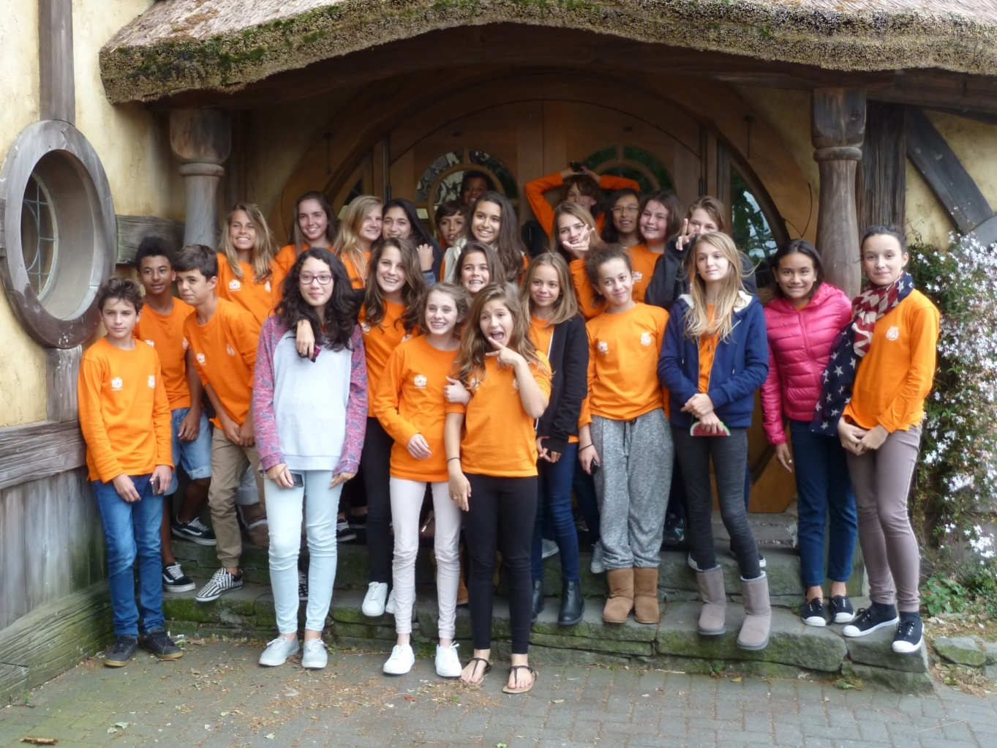
The departure
On Friday 23 October we left Nouméa to go to Taupo with our teachers: Mrs Smaghe, Mrs Perraud and Mr. Raimondeau.

Slide 3
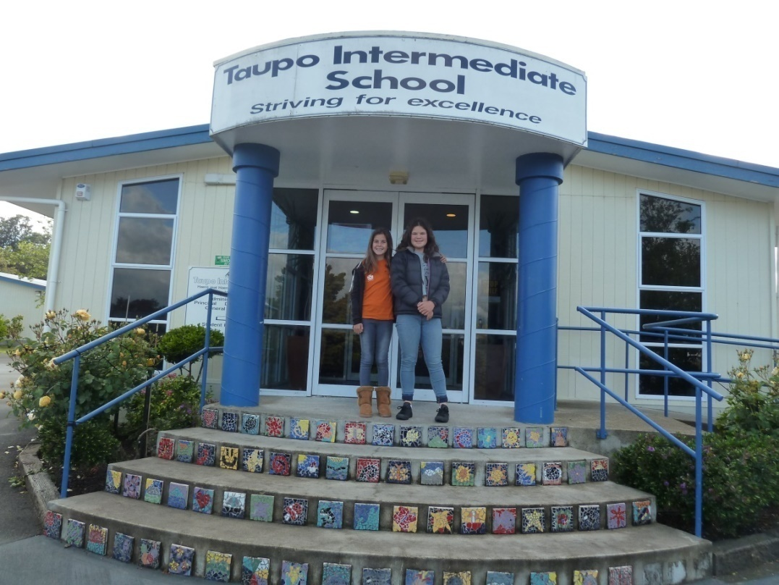
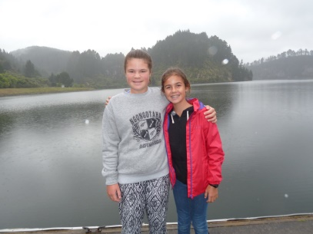
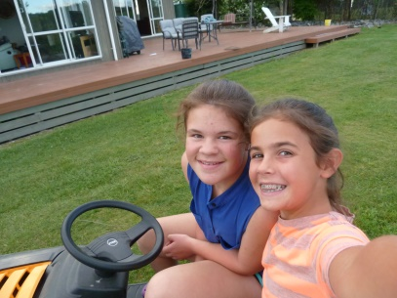
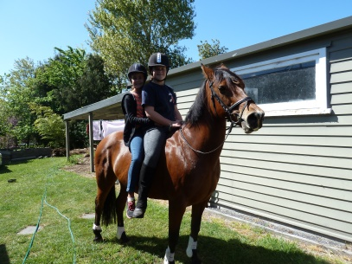
I met Olivia again!!
When we arrived at the school I met my billet Olivia again.

Slide 4
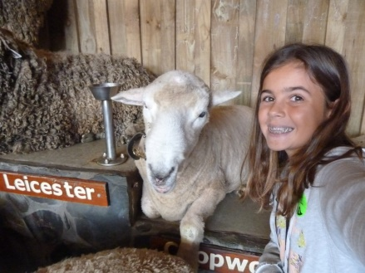
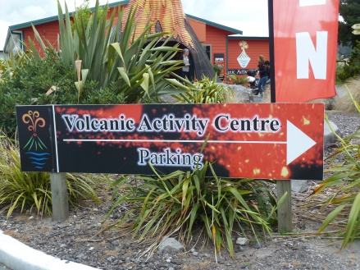
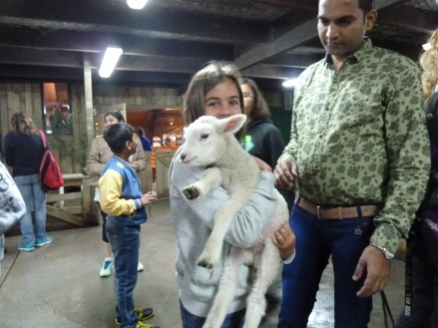
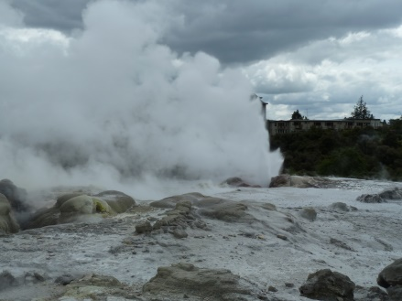
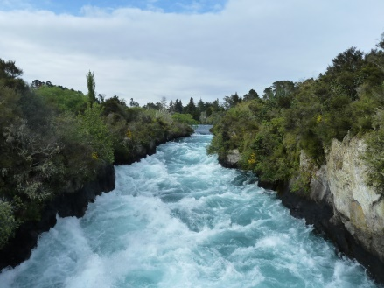
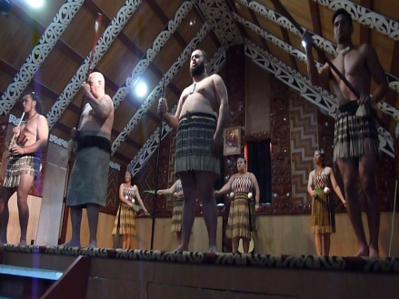
The activities with the class
We visited the Agrodrome, we saw geysers and a Maori show in Rotorua, the Volcanic Center and Huka Falls in
Taupo!

Slide 5
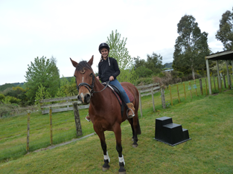
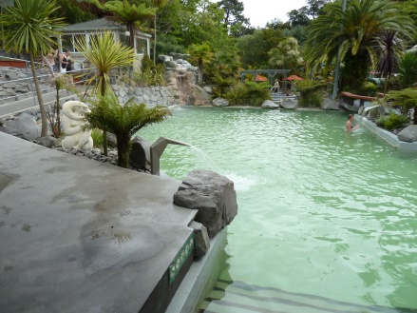
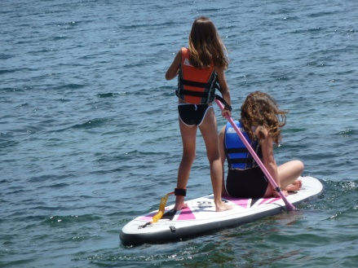
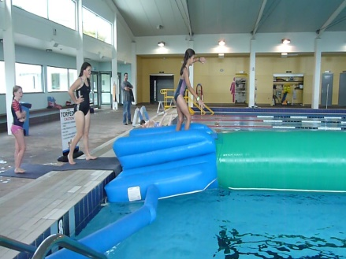
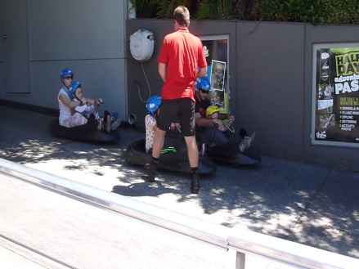
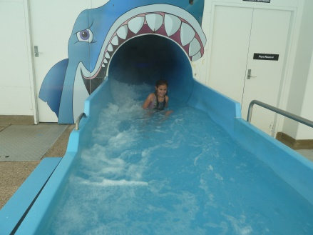
Activities with my host family
I tried horse riding, I went shopping, paddling, and had a go on the luge. I had a swim at the hot pools at ‘DeBretts’ and ‘AC Baths’. It is a big swimming pool with water games!!!

Slide 6
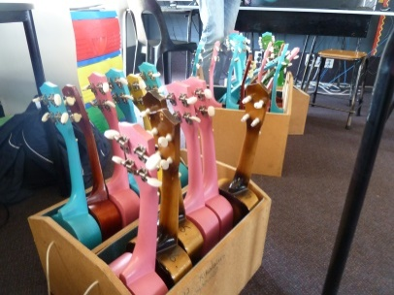
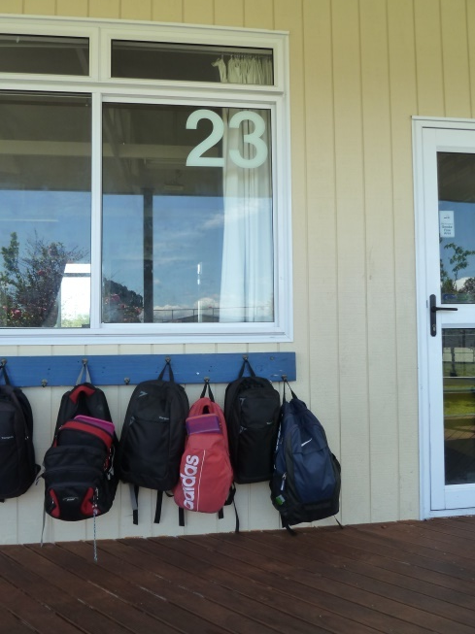
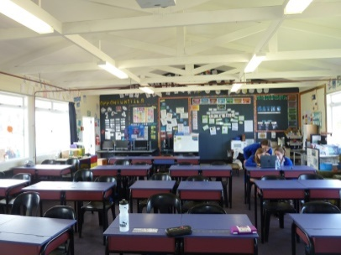
The school
It is very different from our school because pupils stay all day in the same classroom and have one teacher. They work a lot on their computers and don’t have much homework. Days at school are short from 9am to 3pm. Pupils eat what they have in their lunch box. On Tuesdays and Thursdays afternoon, Olivia’s class was doing arts, DIY, sewing or cooking. On Wednesday afternoon, Olivia’s class would learn how to play Ukulélé.

Slide 7
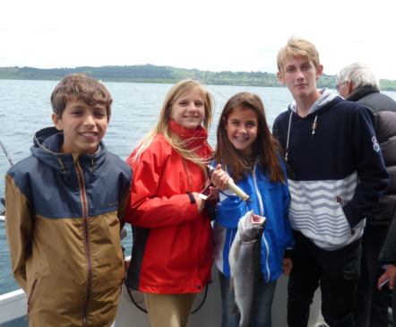
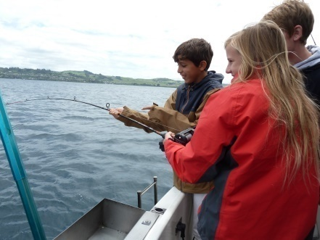
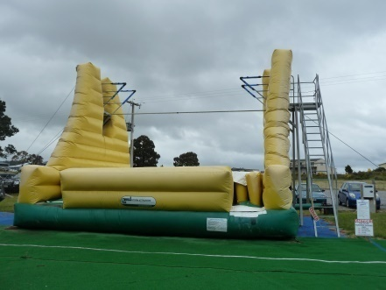
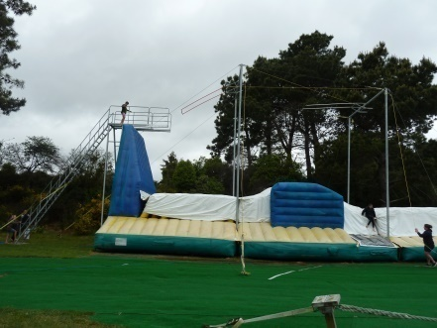
Activities with the school
Mrs WESTERMAN (the French teacher) and Mr CLARK (the principal) took me fishing with Lilou, Lucas and our billets. I also went to Action world with Olivia’s class. It was so great!!!

Slide 8
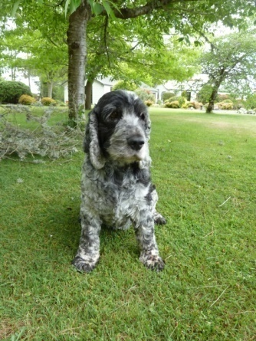
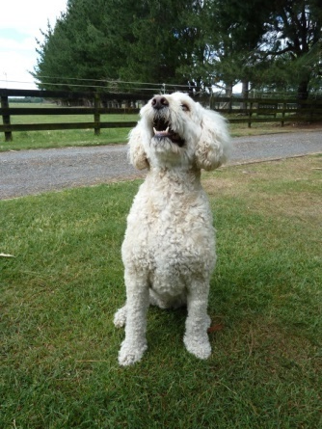
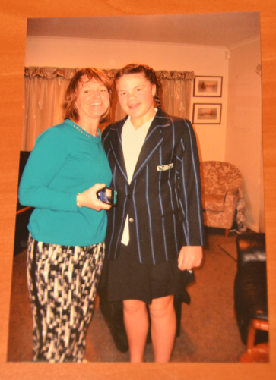
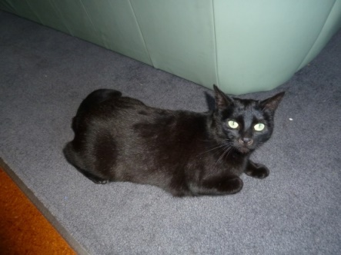
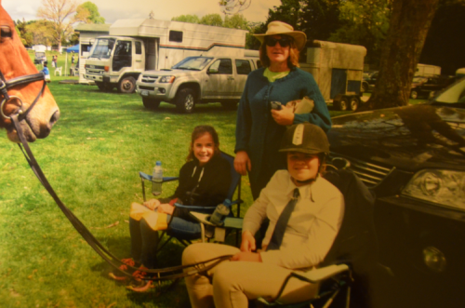
My host family
I really enjoyed my stay with Olivia and her family. They took great care of me. They live on a farm. I loved their horses, dogs and their cat !!!

Slide 9
Thank you
Due to this wonderful experience, I am now more autonomous, I understand English better and speak it more fluently . I’ve discovered a new culture and way of living. I will never forget this trip and if I had to do it again I would without any hesitation.
A big thank you to Olivia and her family for having hosted me and to Mrs WESTERMAN et Mr CLARK for always being there for us and for doing their best to make our stay enjoyable.
I also thank Mrs LISNIC et Mrs PERRAUD for selecting me for the longstay project!

