Slide 1
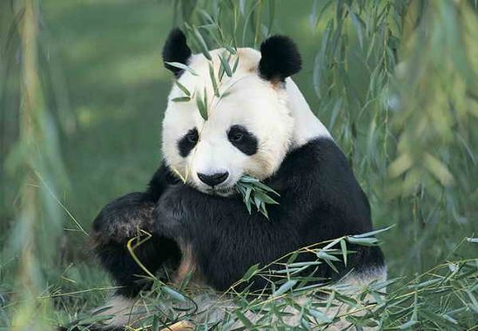
Giant panda
lisa

Slide 2
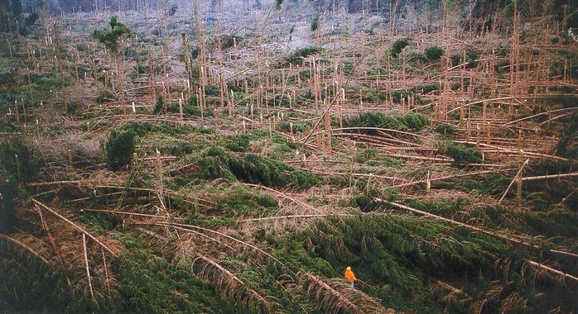
Endangered species
The giant panda is an endangered species because roads fragmenting the forest, wich isolates panda populations and prevents mating.
It’s time to react

Slide 3
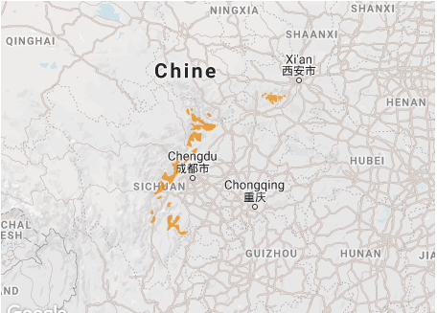
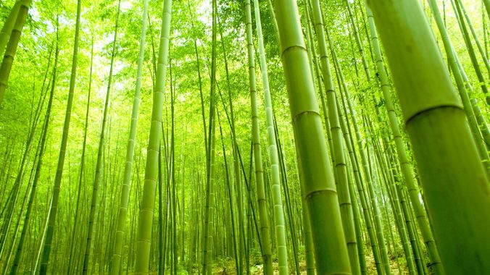
general information
They live in china
They eat bamboos (11 to 38 kilos a day)

Slide 4
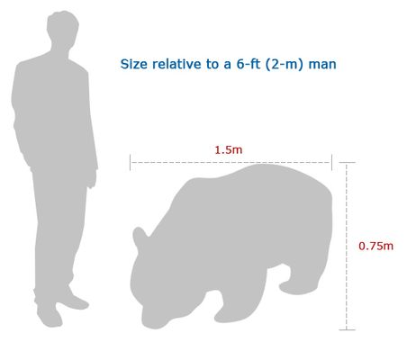

Description
Giant panda can mesure more than 1, 22 meters.
They can weight up to 100 kilos.

Slide 5
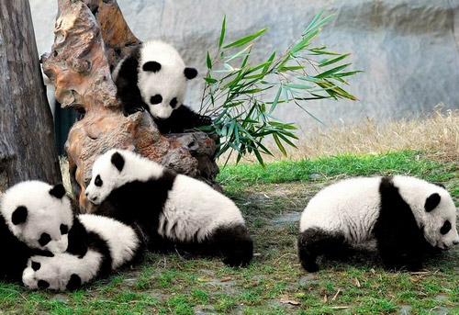

Interesting facts
Giant panda are 1 864 in the wild
For china is a national symbol

Slide 6

