Slide 1
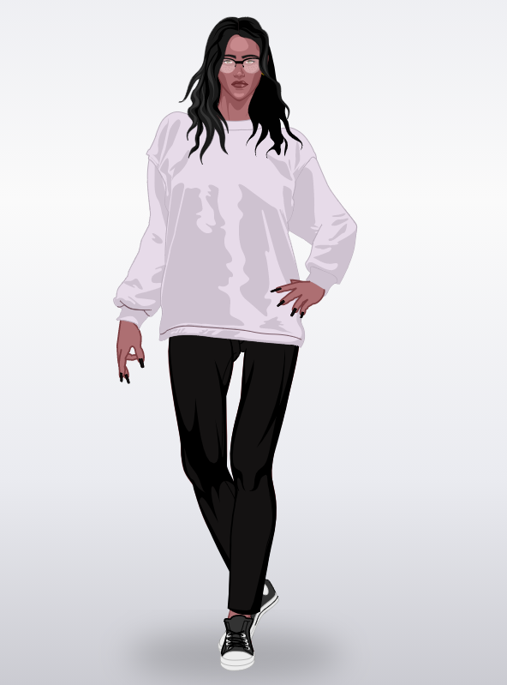
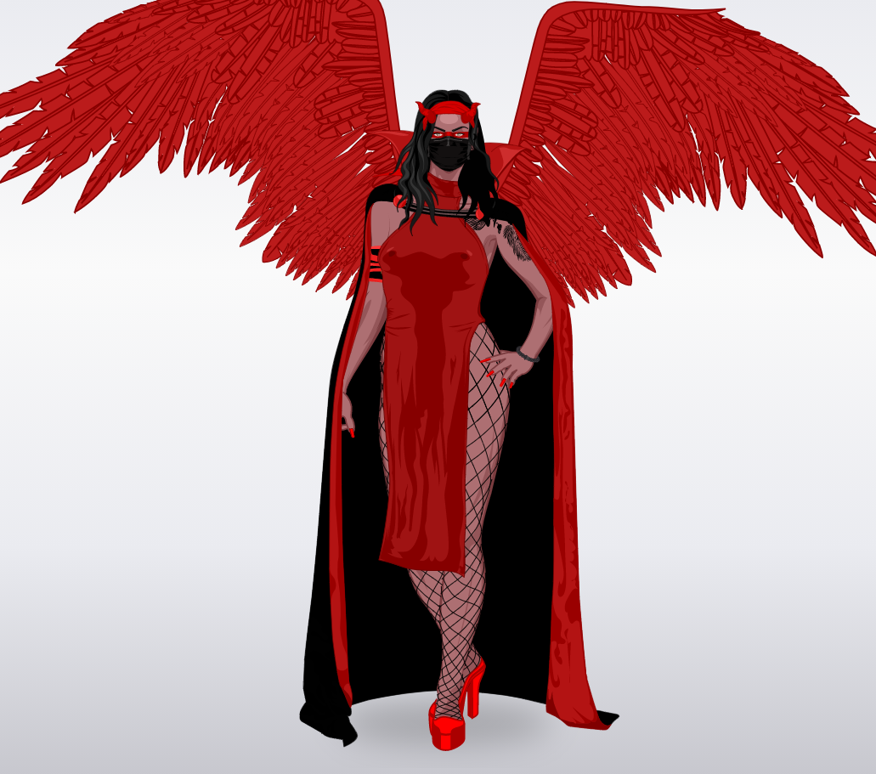
Lyra
Normal Form
Demonic Form

Slide 2
The story of Lyra :
Lyra was three years old when her village got attacked by a herd of wild animals such as lions and tigers. Lyra was so terrified of all the animals that she started to cry. After several hours of suffering, a lion with a crown came to her, and gave her a Godly Gem. After that, the crowned lion gave her the Godly Gem, Lyra felt asleep. After 1 week of sleeping Lyra woke up, and didn’t remember anything but she saw that she has wings and devil horns. Lyra was lost in the forest but when she found a city she became human and live a normal life and when she found a forest she transfroms in demonic form.
Powers of Lyra :
Lyra can kill her enemies with her venomous devil horns and she has the capacity to fly.
With her red wings she can strangle all her enemies and people she likes to.
She is also able to teleport her enemies and kill them but she can’t use her mouth because of her mask.
Physical description :
Lyra has red wings and devil horns. She also has a black mask on her face and she wears a long red dress. Lyra is tall with her 600 ft and pretty strong. But in normal form she is a Human.
Enemies :
The enemies of Lyra is Demonia and Mystic. Lyra and Demonia were best friend before Demonia betray Lyra with her parrot. Demonia created a trap to kill Lyra but Lyra knew it and didn’t fall in the trap.
Florent 301

