Slide 1
A Review of English Painters and Paintings
503- Junior High School : Louise Michel Paita

Slide 2
Contents :
1° : Peter Blake-Ynès et Lila
2° :William Turner- Luciana et Cordélia
3° : John Constable-Ryan et Bradley
4° : Francis Bacon-Samuel et Setasio
5° :Nicolas Hilliard - Loïs
6° : Ben Nicholson - Ketsia , Marie-Emilie et Ayiana
Supervisors: Alan & Guillaume

Slide 3
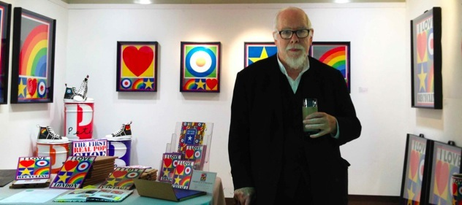
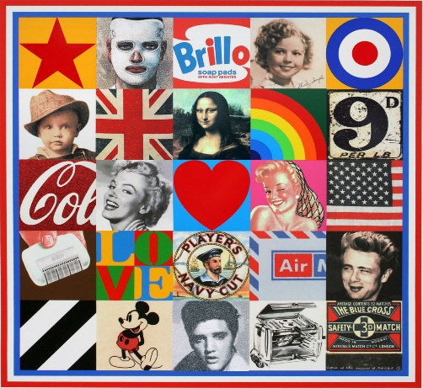
PETER BLAKE
His Name is Sir Peter Thomas Blake . He was Born on 25 june 1932 in Dartford , Kent , England, He is 89 . He is an artist who does pop art works. His Works represents things related to fashion or brands.

Slide 4
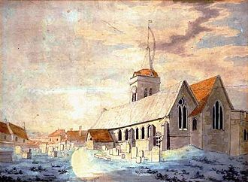
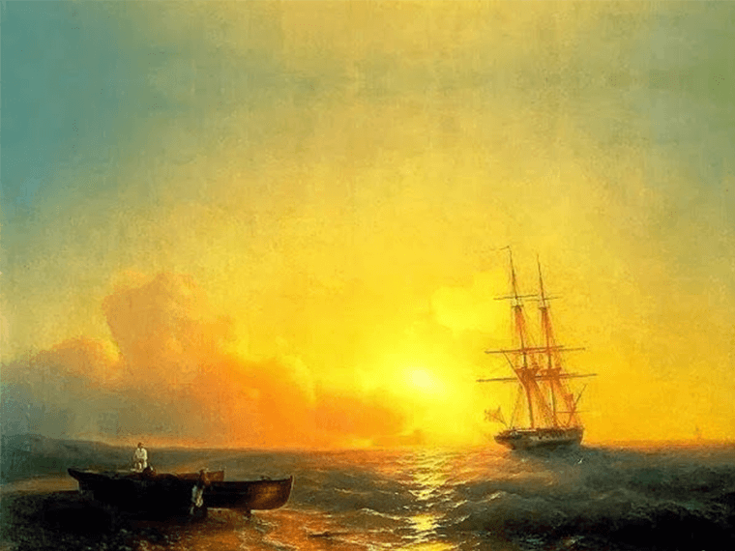
William Turner
Picture description
This is a work by William Turner.
It shows us a bright sunset with boats on the ocean and the waves are crashing on the beach.
William Gay Turner had his shop near St. Paul's Church. His mother, Mary Marshall, came from a butchers' family and gradually lost her reason and entered hospital. She died there in 1804. One of the reasons for her folly was probably the death of William's younger sister, Mary Ann, who was born in September 1778 and died in August 1784 before she was six years old. If his relations with his mother were difficult, it seemed that despite this context, Turner's childhood was "warm".
The young Turner was sent in 1785 to one of his maternal uncles in Brantford, a small town on the banks of the Thames, in Middlesex, west of London.

Slide 5
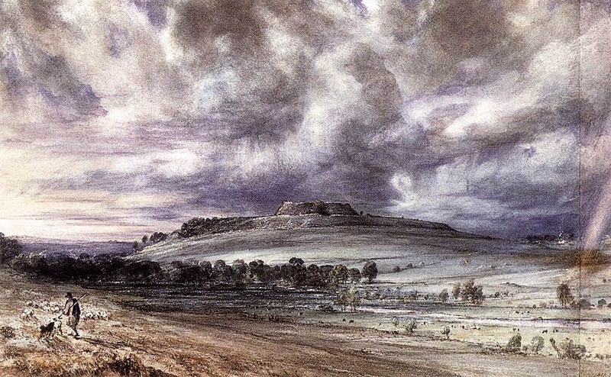
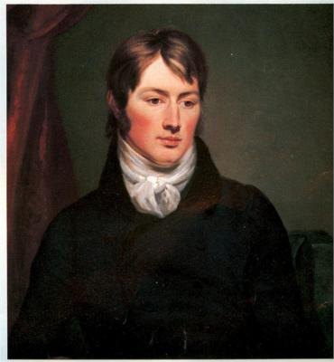
John Constable
John Constable was Born in East Bergholt, a village on the River Stour in Suffolk, and he died on 31 march 1837. He became a member of the establishment after he was elected to the Royal Academy at the age of 52. His work was appreciated in France, where he sold more paintings than in his native England and inspired the Barbizon school. He did romantic art. Constable's most famous paintings includes Wivenhoe Park, 1816.

Slide 6
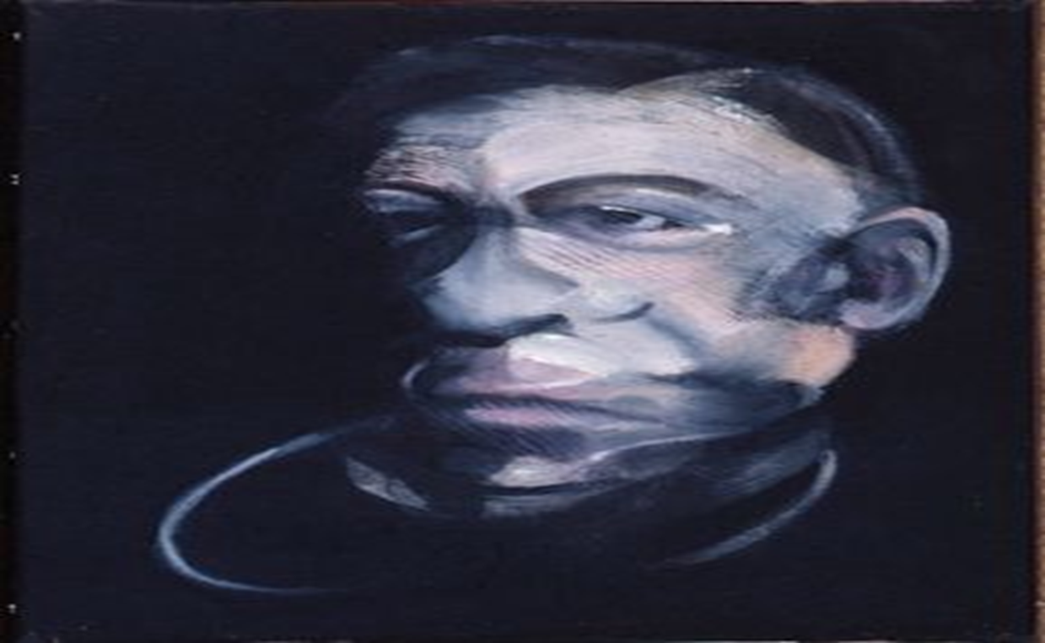
Francis Bacon
Francis Bacon, an Irish painter, was born on October 28, 1909 in Dublin to English parents. He died on April 28, 1992 in Madrid, following pneumonia triggered by the asthmatic disease he was as a child . To create this work, Bacon got inspired from the Crucifixion Picasso painted in 1930.

Slide 7
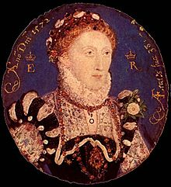
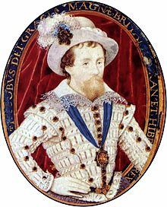
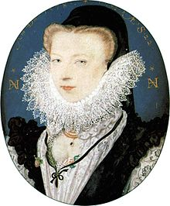
Nicholas Hilliard
Nicholas Hilliard was born in 1547, Exeter and died on January 7, 1619, London.
He was the first great English painter of the Renaissance.
His lyrical portraits raised the art of painting miniature portraiture (called limning in Elizabethan England) to its highest point of development and did much to formulate the concept of portraiture there was during the late 16th and early 17th centuries.

Slide 8
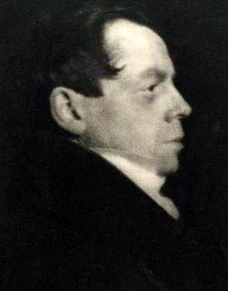
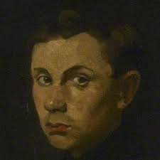
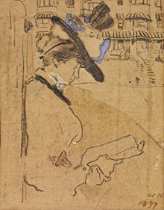
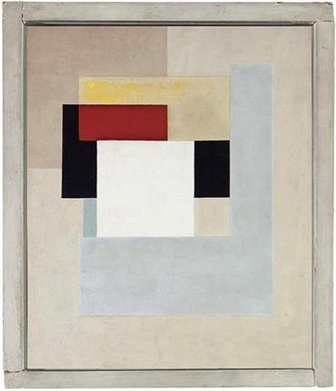
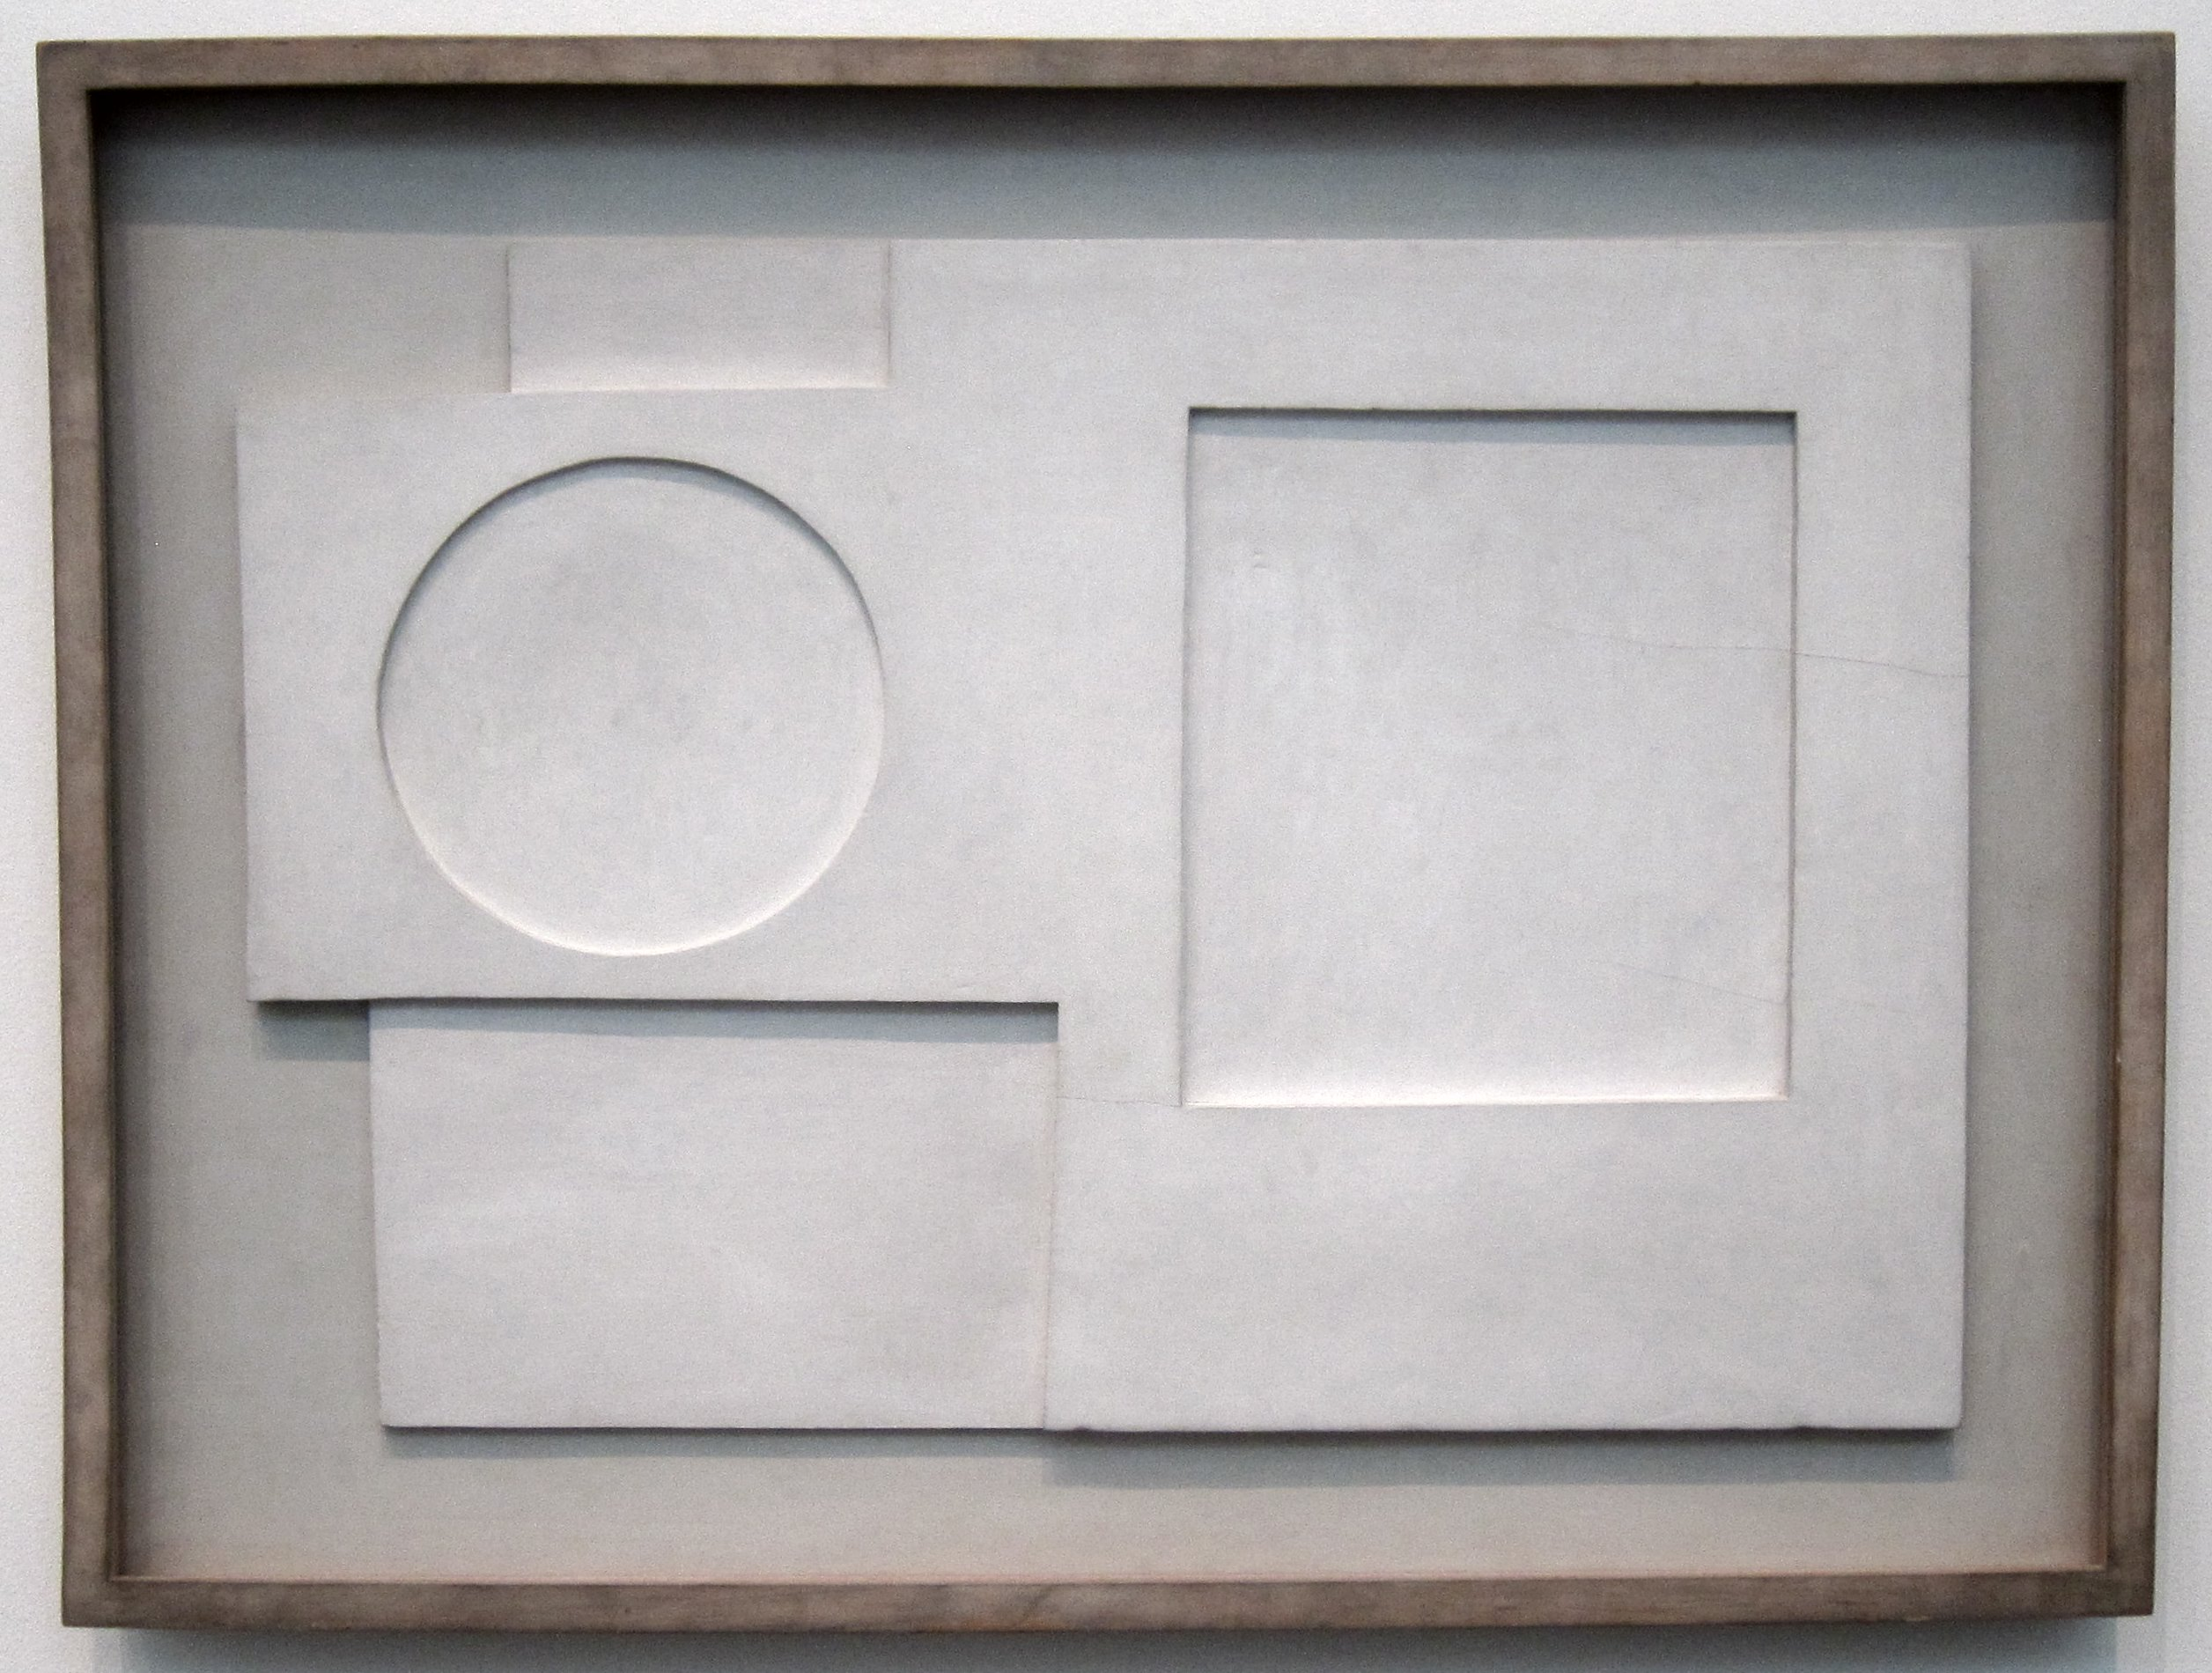
Ben Nicholson
His identity
He was born on April 10, 1894 in Denham
He died on February 6, 1982.
He was a Cubist artist . He did abstract art and modern Art
He married three times with Felicitas Vogler, Barbara Hepworth and Winifred Nicholson. He visited Paris and he met Mondrian, He was also influenced by Picasso.
He made his own style of work
His Works of art

