Slide 1
On Labour Day, we … go to school.

Slide 2
On Christmas Day, we are … together.

Slide 3
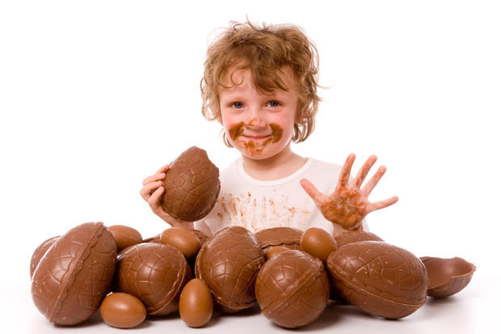
On Easter Day, I /eat chocolate.

Slide 4
On Labour Day, my family /offer a lily-of-the-valley

Slide 5
On Bastille Day, we / watch the fireworks.

Slide 6
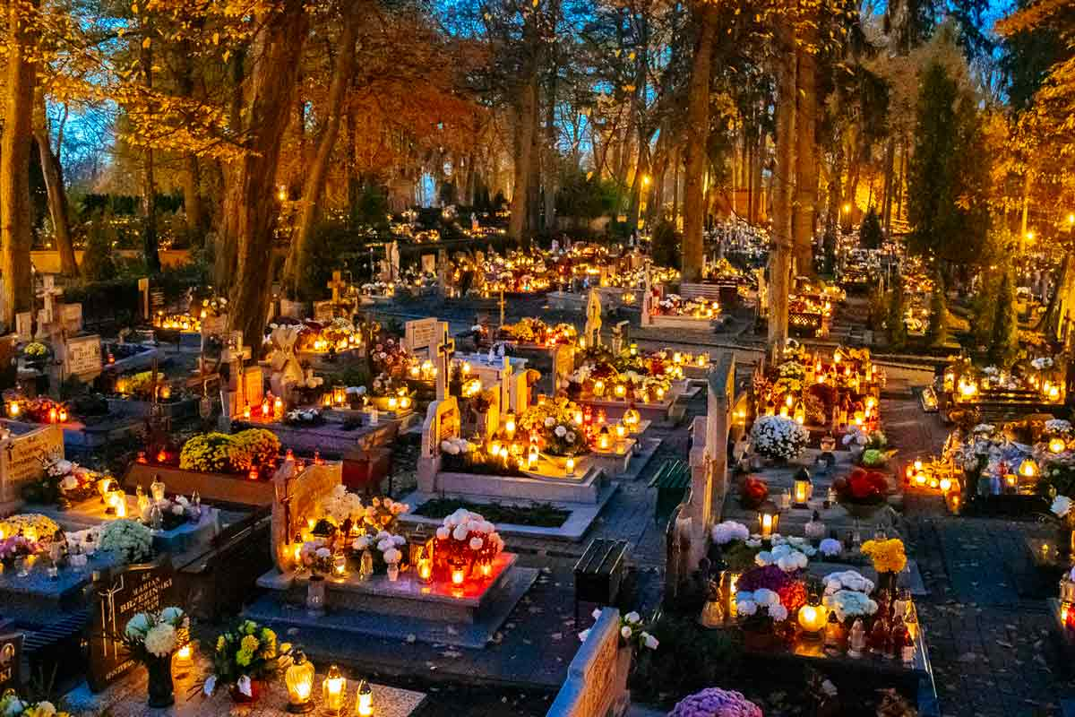
On All Saints’ Day, my family / go to the cemetery

Slide 7
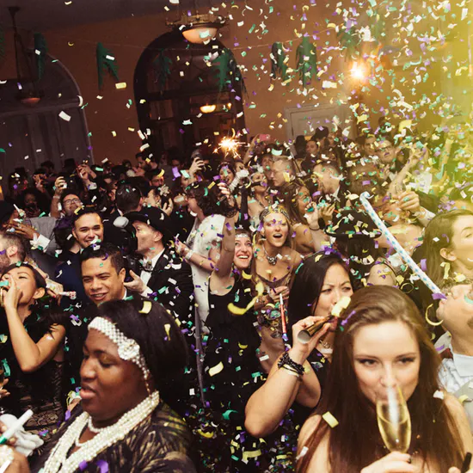
On New Year’s Eve, we / have a party.

Slide 8
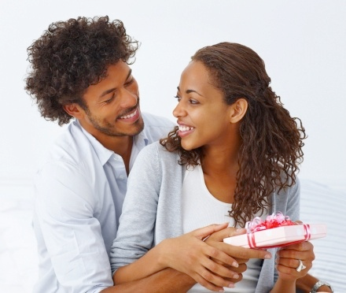
On Valentine’s Day, my Dad / my parents…

