Slide 1
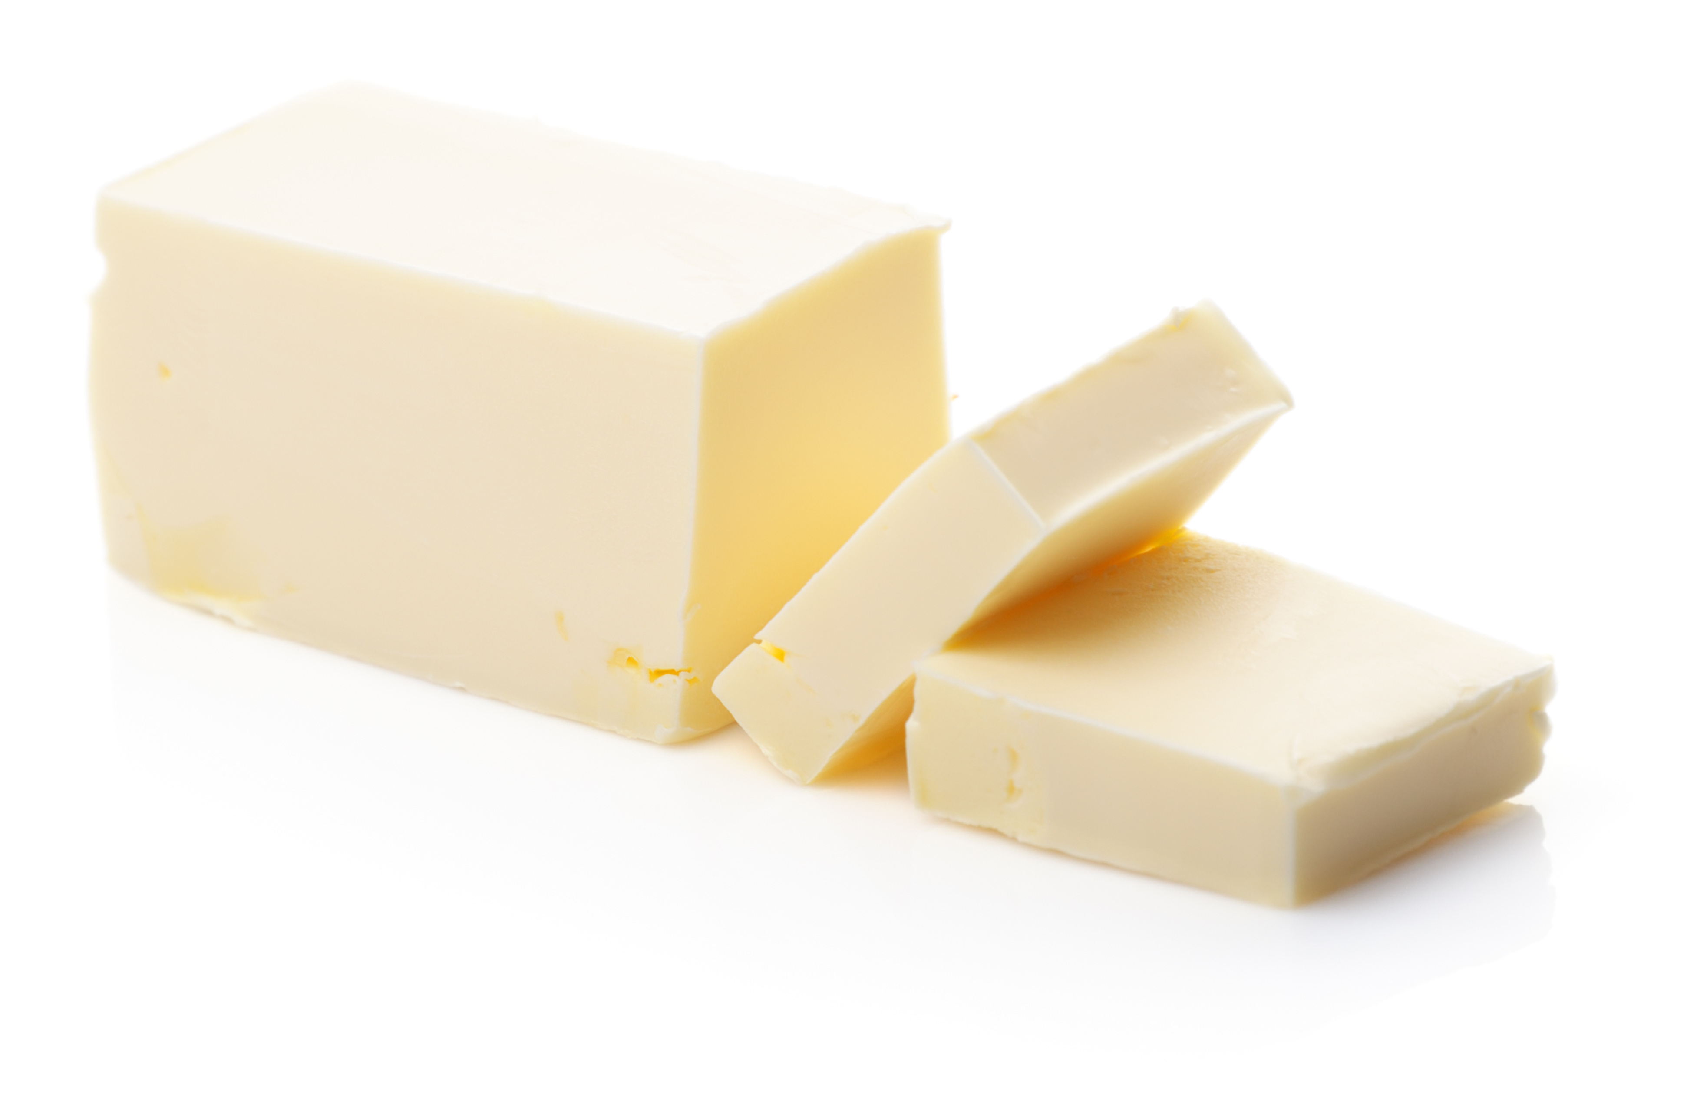
BUTTER

Slide 2
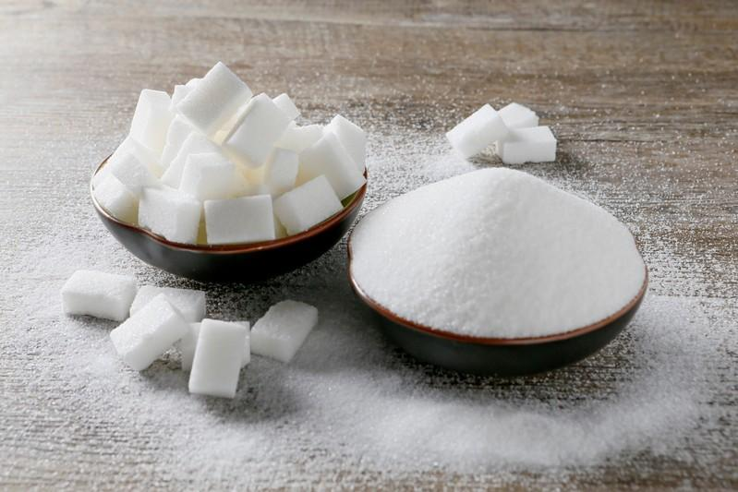
SUGAR

Slide 3
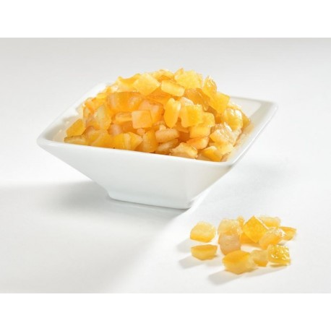
ORANGE PEEL

Slide 4
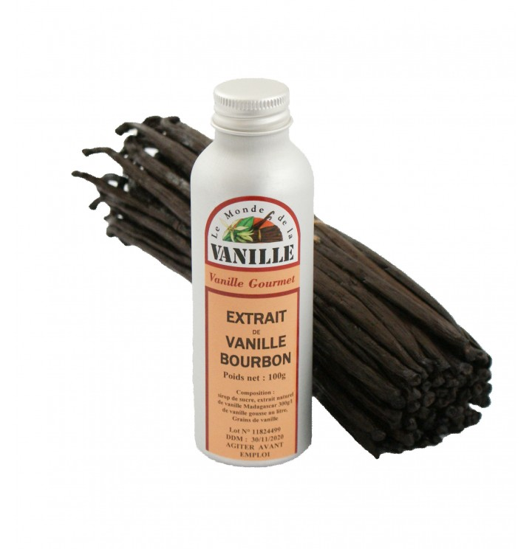
VANILLA EXTRACT

Slide 5
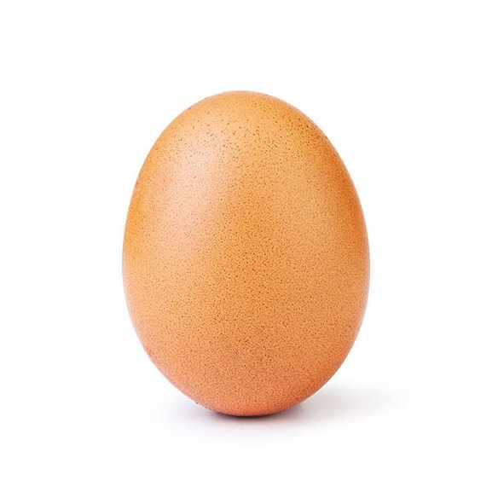
AN EGG

Slide 6
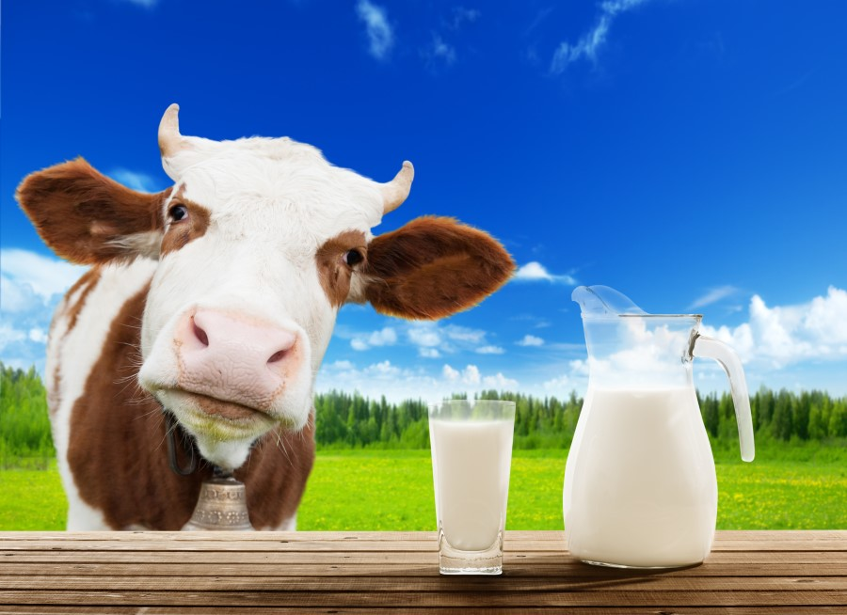
MILK

Slide 7
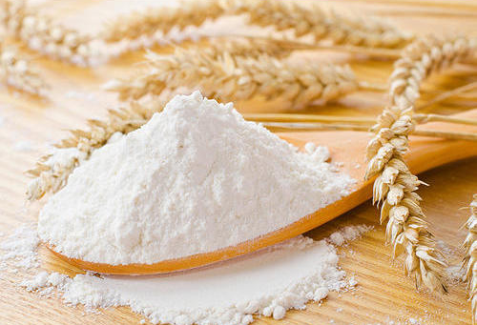
FLOUR

Slide 8
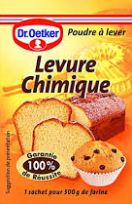
BAKING POWDER

Slide 9
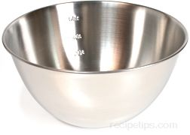
A BOWL

Slide 10
A TEASPOON

Slide 11
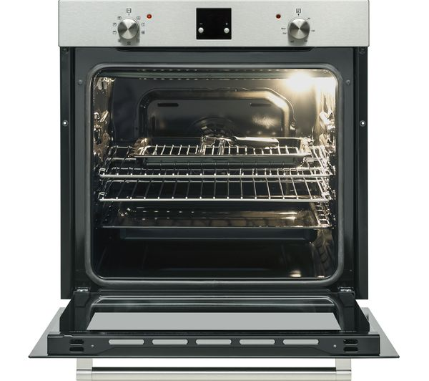
AN OVEN

Slide 12
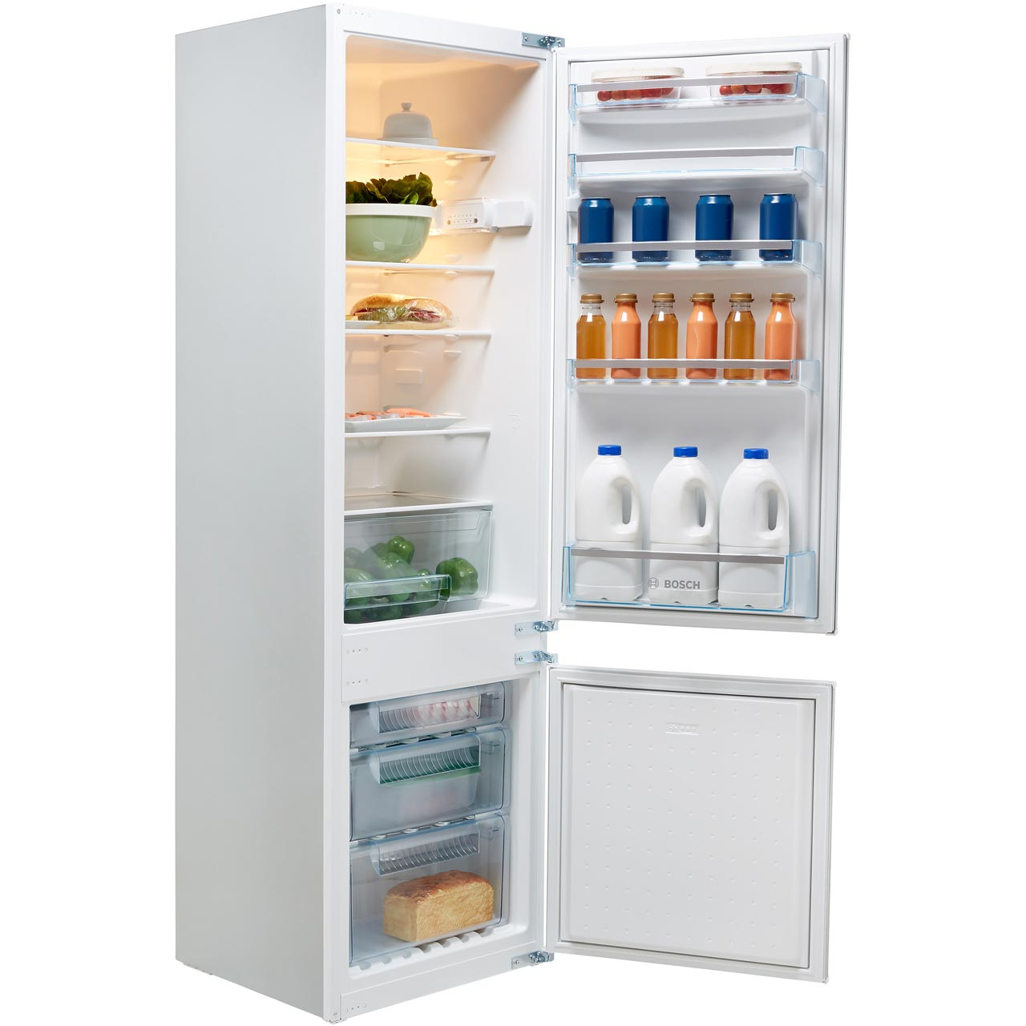
A FRIDGE

Slide 13
Instructions

Slide 14
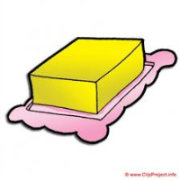
Mix the butter and the milk.
No!

Slide 15
Mix the butter and the sugar.

Slide 16
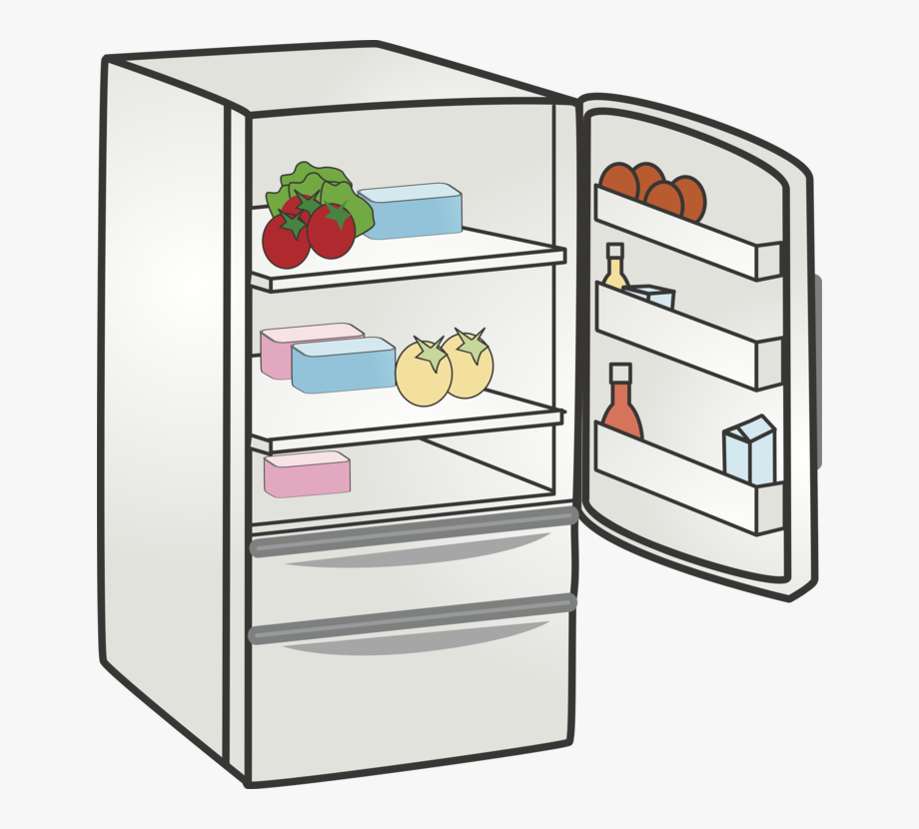
Put in the fridge for 10 mn.
No!

Slide 17
Put in the fridge for 1 hour.

Slide 18
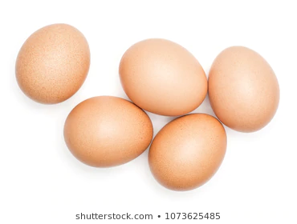
Add 5 eggs

Slide 19
Add 1 egg

Slide 20
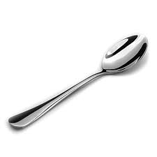
Add 10 teaspoons of milk.

Slide 21
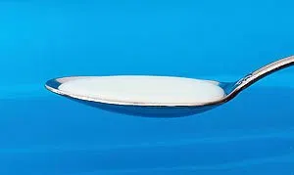
Add 4 teaspoons of milk.

Slide 22
Cut into heart shapes.
No!

Slide 23
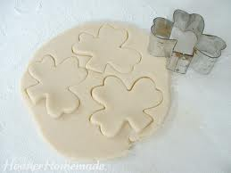
Cut into shamrock shapes.

Slide 24
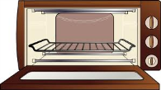
Bake in the oven for 20 minutes.
45
No!

Slide 25
Bake in the oven for 6 to 8 minutes.

Slide 26
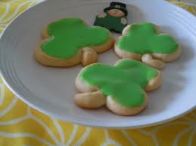
Put the green food colouring on the cookies when they are hot.
No!

Slide 27
Put the green food colouring on the cookies when they are cold.

