Slide 1
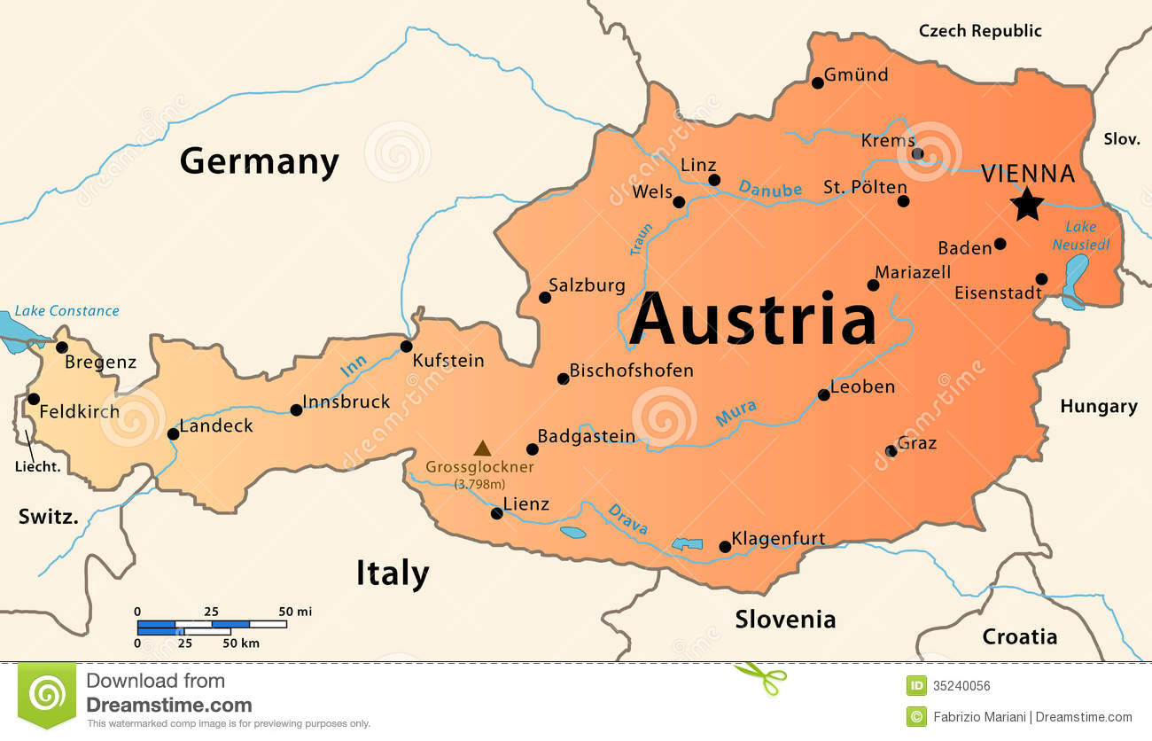
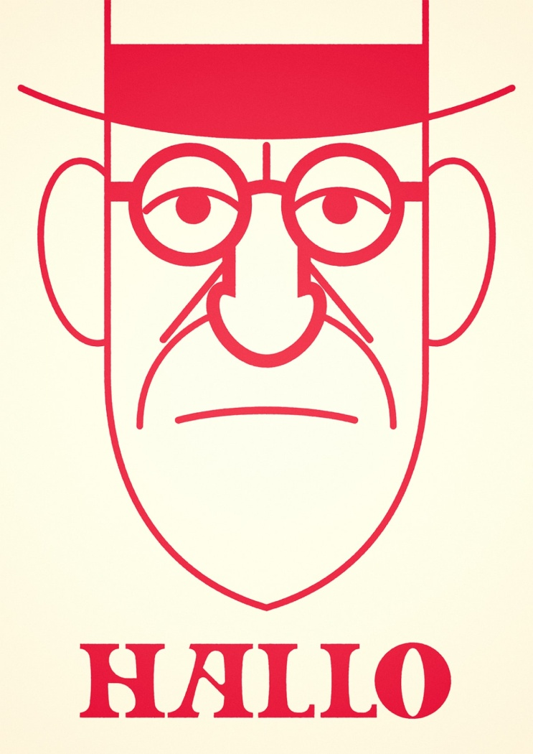
Austria accesion date to the EU: 1fst January 1995
Capital: Vienna
Official language: German
Population: 8.773 million of people
Area: 32 386 mi2
Head of state: Alexander Van der Bellen
Historic sites: Schonbrunn Palace, Vienna State Opera, The Belvedere Palaces
Culinary Specialities: Rindsuppe, Beuschel, Selchfleisch
Personalities: Marie-Antoinette, Arnold Schwarzenegger, Wolfgang Amadeus Mozart

