Slide 1
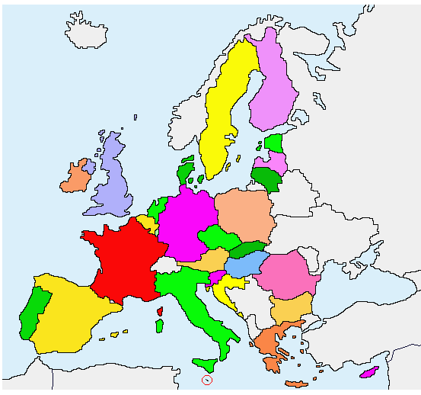
GERMANIC COUNTRIES
Germany
Austria

Slide 2
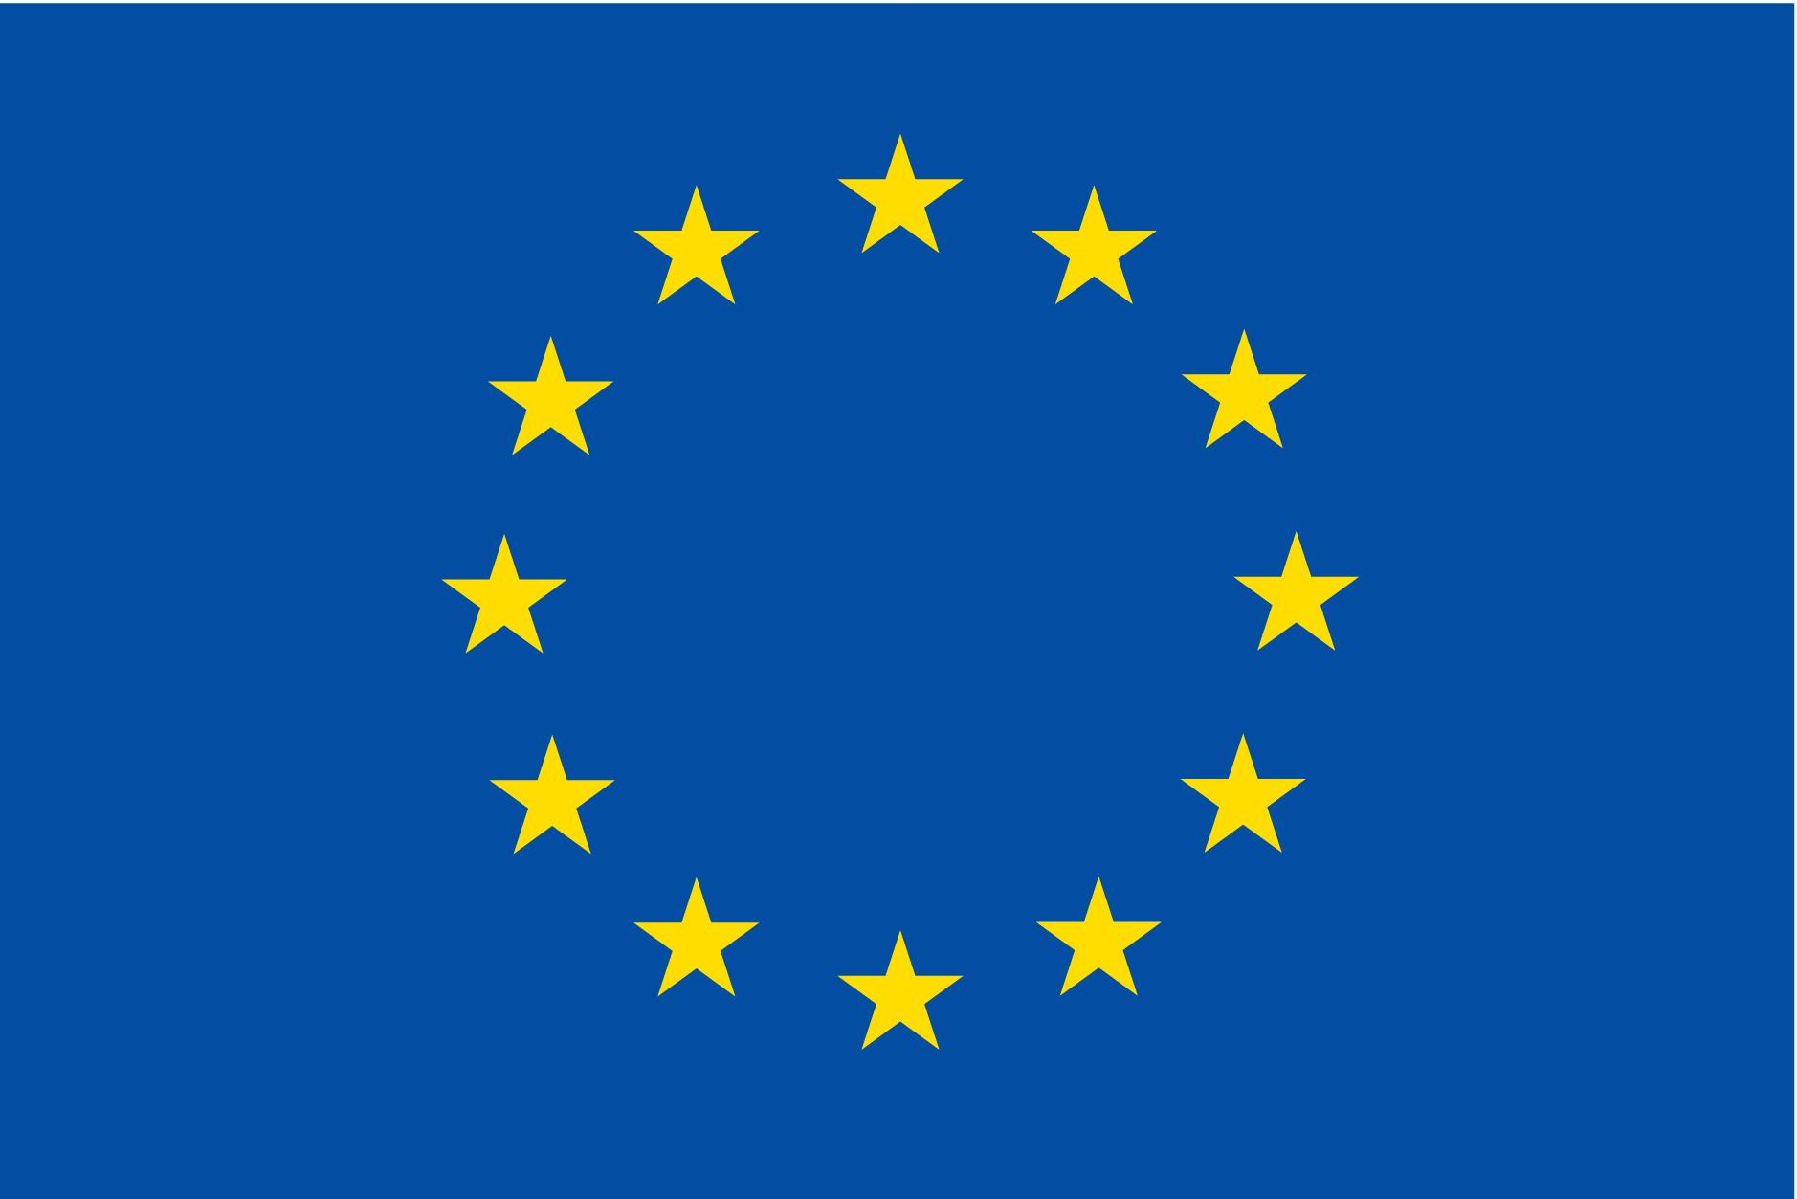
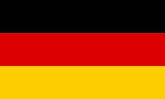
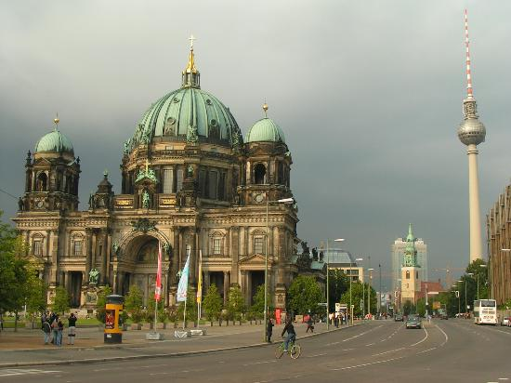
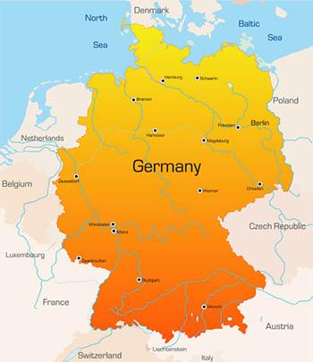
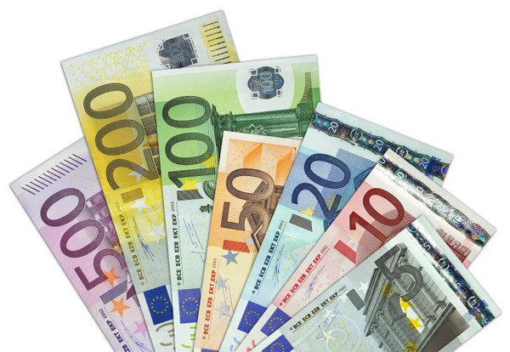
GERMANY
Geographical size: 357 137,2 km2
Capital: Berlin
Official EU language: German
Currency: Eurozone member since 1 January 1999

Slide 3
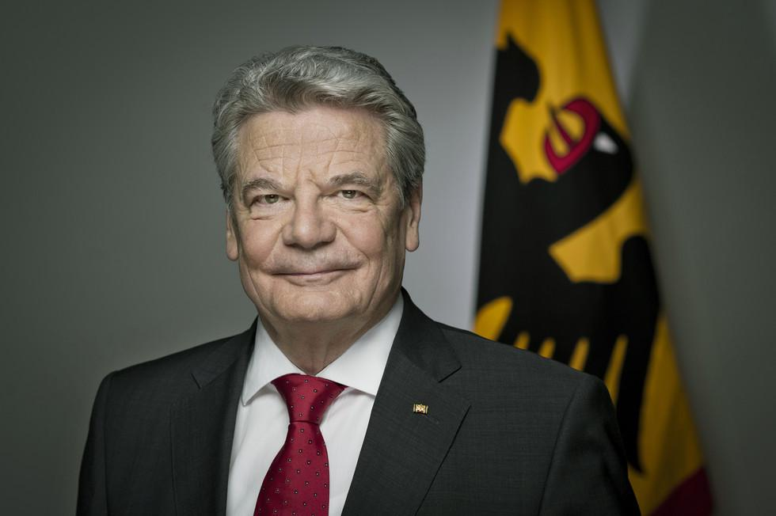
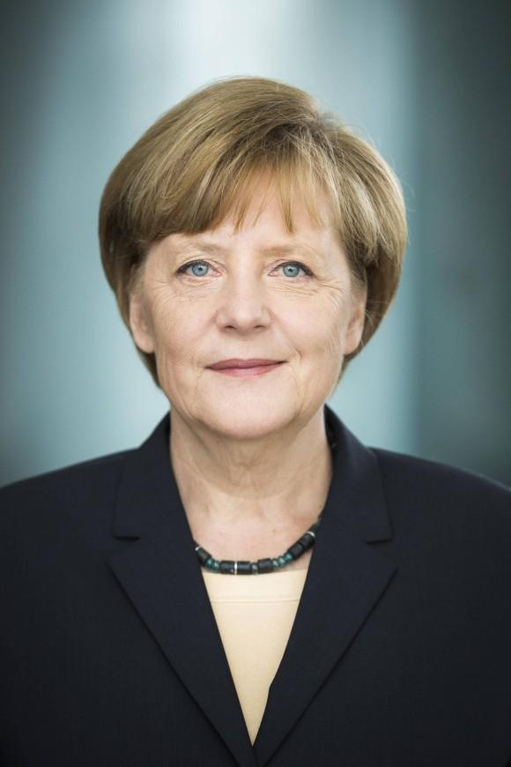
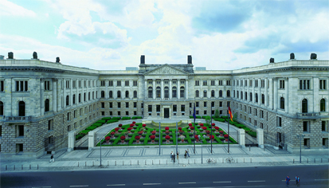
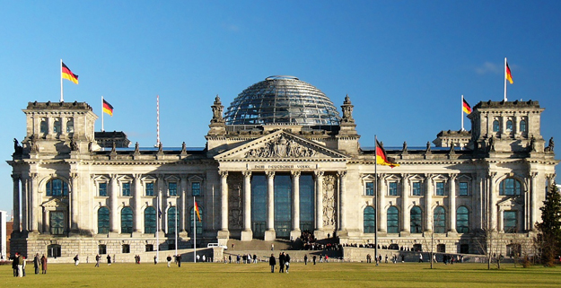
Political system: Parliamentary federal republic
Federal president: Joachim Gauck
Chancellor: Angela Merkel
Upper house: Bundesrat
Lower house: Bundestag

Slide 4
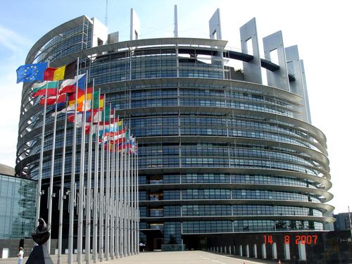
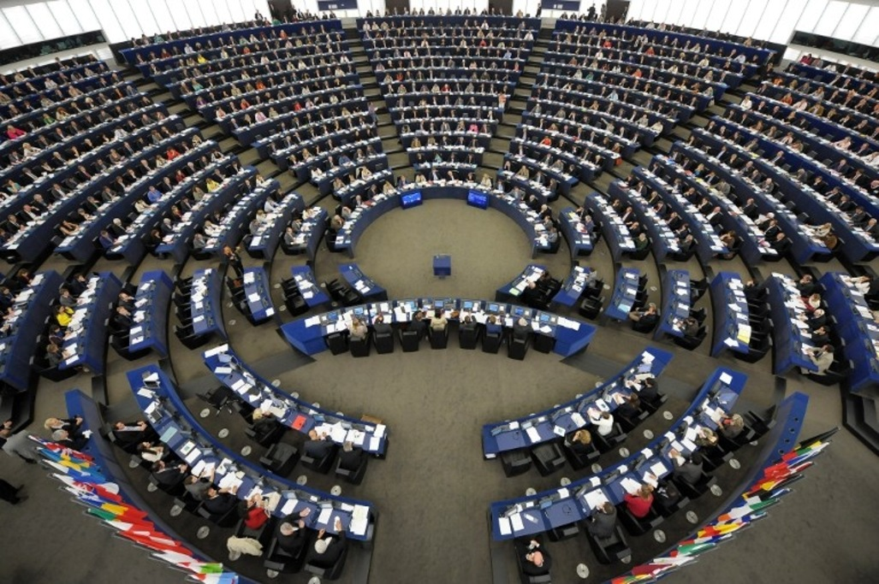
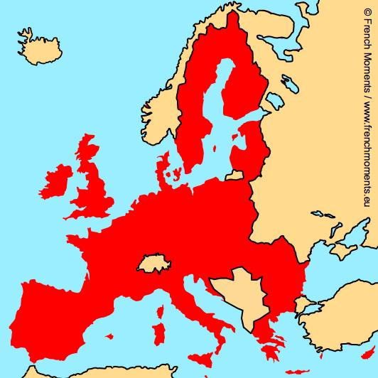
Schengen area member? Yes, Schengen Area member since 26 March 1995.
EU member country since: 1 January 1958
Seats in the European Parliament: 96
Presidency of the Council:Germany has held the revolving presidency of the Council of the EU 11 times between 1958 and 2007.

Slide 5

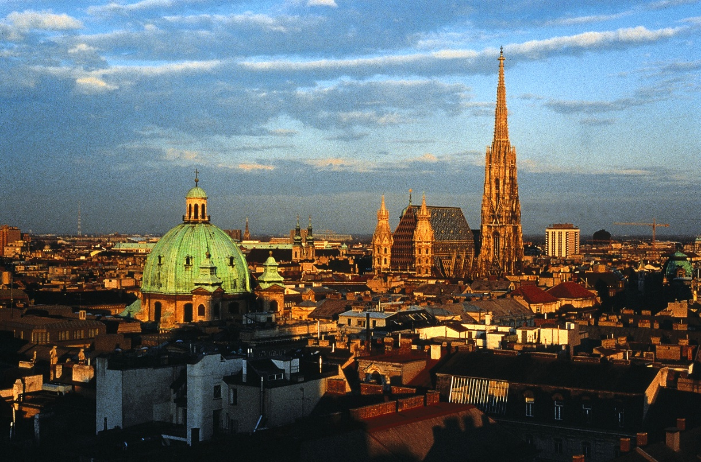
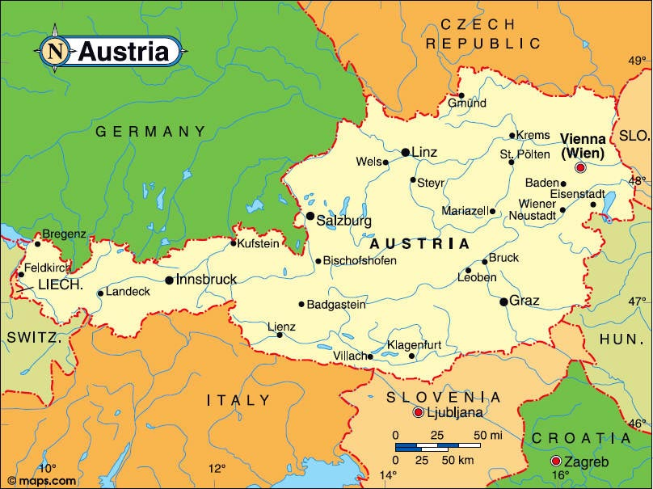
Population: 8 507 786
As 1,7% of EU population
AUSTRIA
Capital : Vienna
Geographical size: 83 879.0 km²

Slide 6
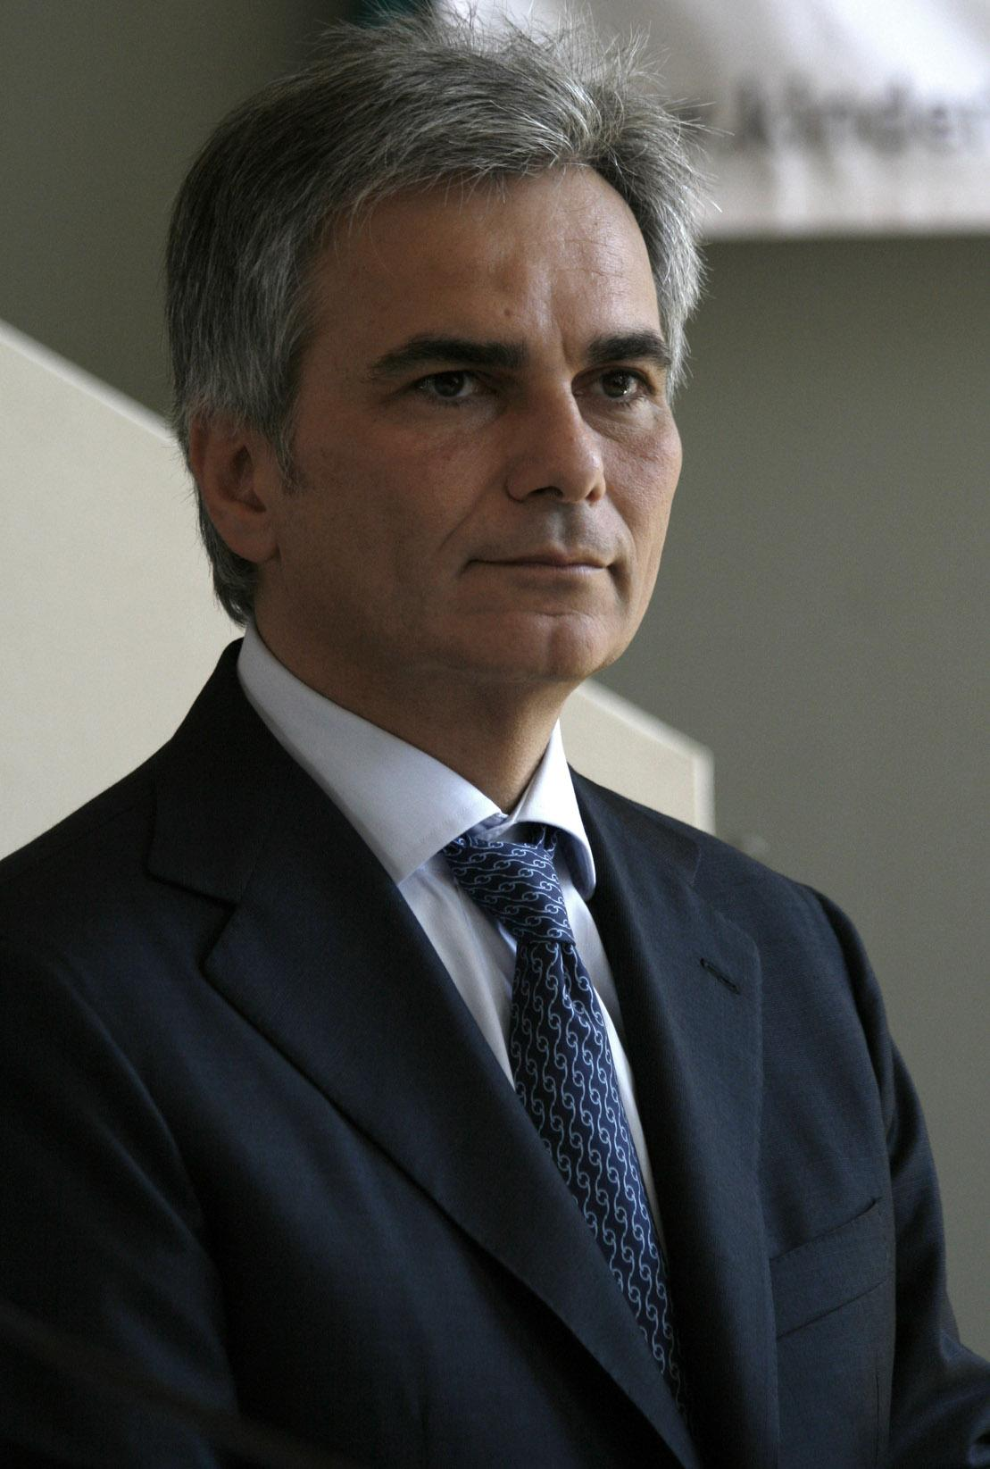
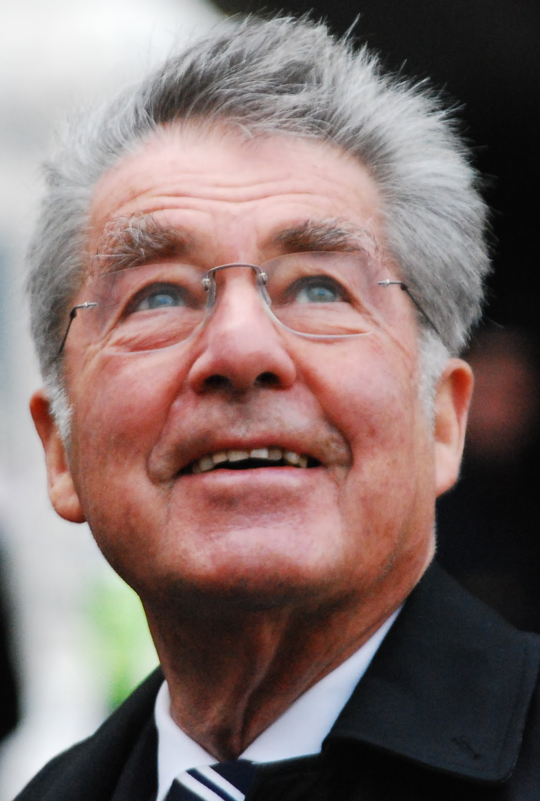
Chancelor of Austria
President of Austria
Werner Faymann
Born the:
4 may 1960
Chancelor since:
2 december 2008
Heinz Fischer
Born the:
9 october 1938
President since:
8 july 2004

Slide 7
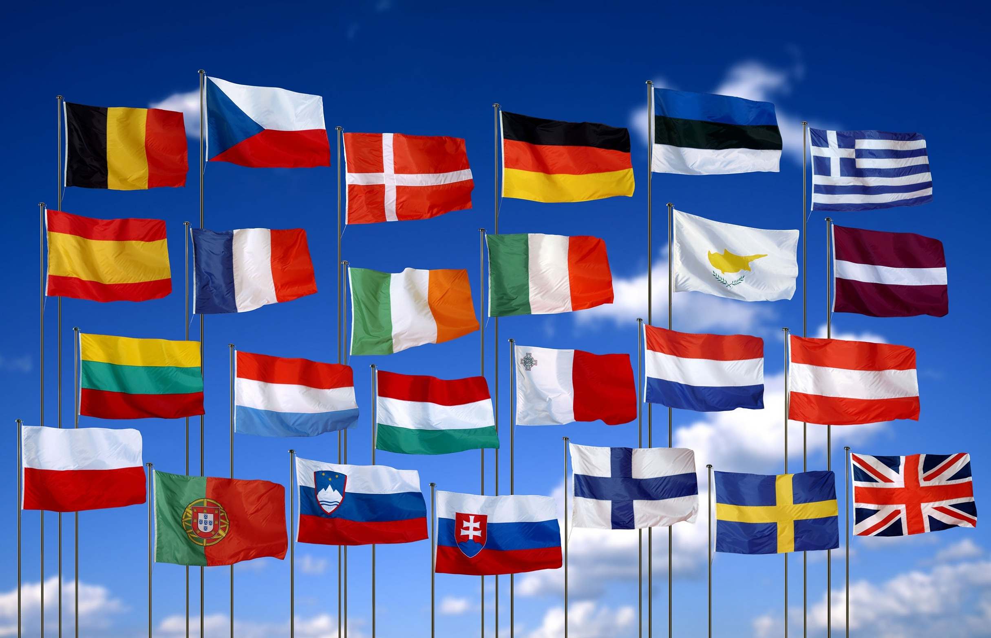
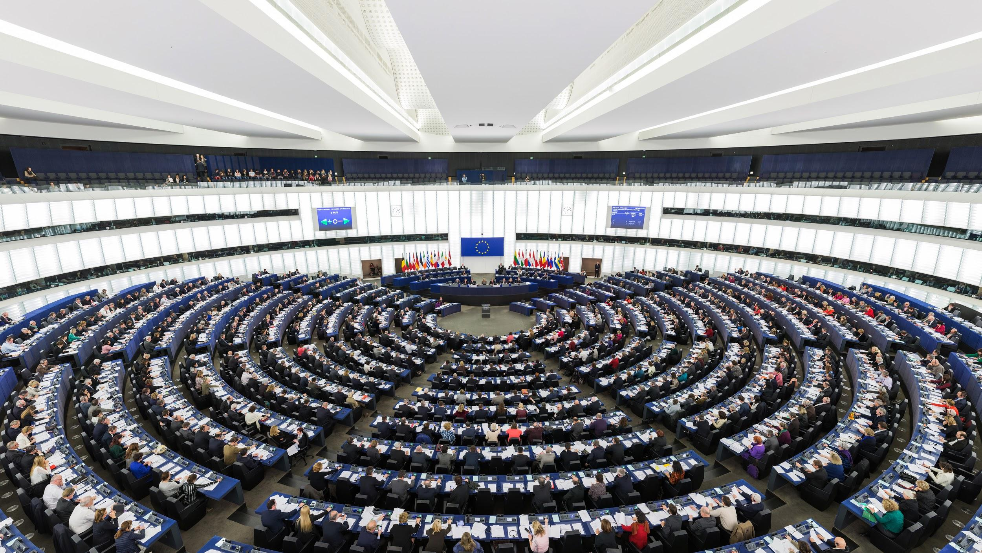
EU member country since: 1 January 1995
Schengen Area member since: 1 December 2007
Eurozone member since: 1 January 1999
18 seats in the European Parliament
Austria has held the revolving presidency of the council of the EU twice: in 1998 and 2006
The next time will be in 2009

