Slide 1
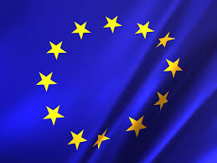
THE EUROPEAN UNION

Slide 2
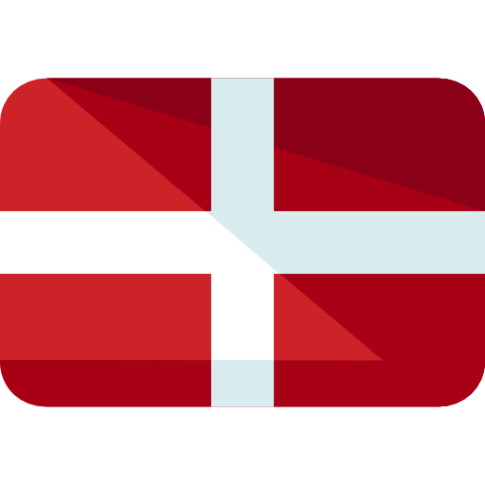
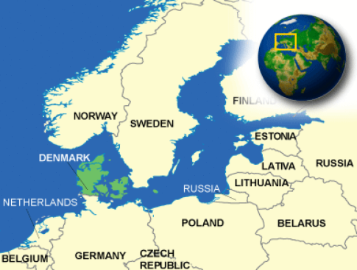
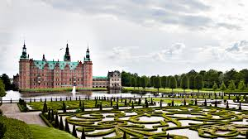
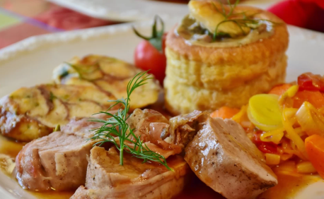
DENMARK
MEMBER OF EU SINCE :1973
HISTORICAL SITES:
Frederiksborg Castle
Viking ship museum
Kronborg Slot
CULINARY SPECIALITIES:
Mørbradbøffer
Smørrebrød
Flæskesteg
PERSONALITIES:
Prince philip
Christian Eriksen
Niels Bohr
CAPITAL: Copenhague
OFFICIAL LANGUAGE: Danish
POPULATION: 5 749 000
AREA: 42 933 km²
HEAD OF STATE:(Prime Minister) Lars Løkke Rasmusse

Slide 3
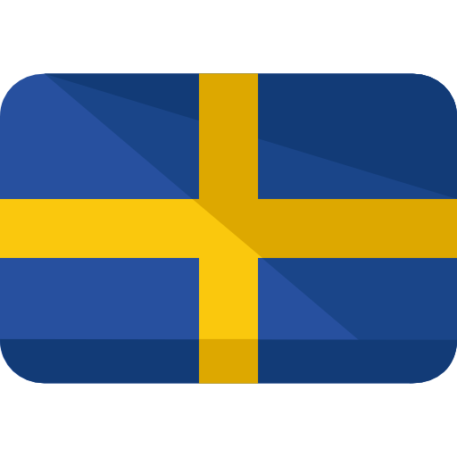
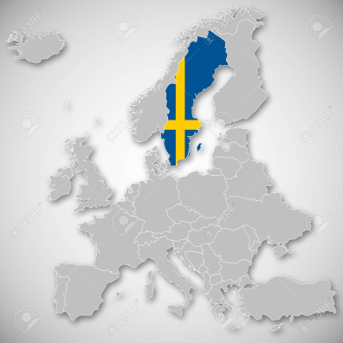
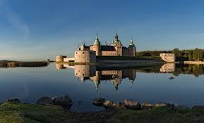
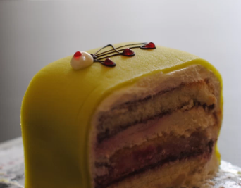
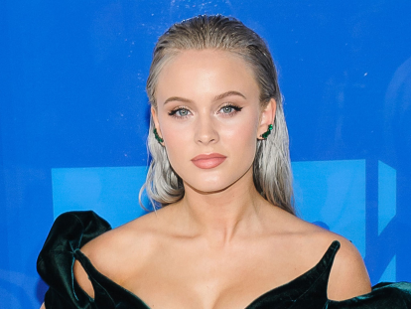
SWEDEN
MEMBER OF EU SINCE :1995
HISTORICAL SITES:
Drottningholm Palace
Kalmar Castle
Vasa Museum
CULINARY SPECIALITIES:
Jansson’s temptation
Raggmunk
Princess Cake
PERSONALITIES:
Avicii
Alfred Nobel
Zara Larsonn
CAPITAL: Stockholm
OFFICIAL LANGUAGE:
POPULATION: 9 995 000
AREA: 447,420 km²
HEAD OF STATE: (King) CARL XVI GUSTAF
Swedish

Slide 4

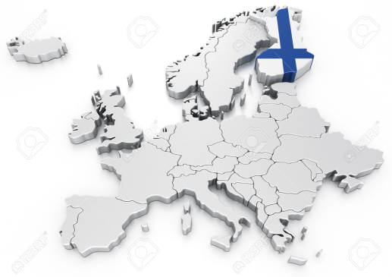
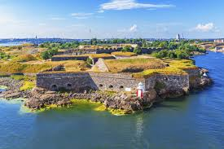
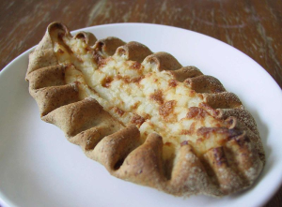
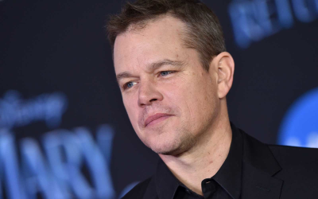
FINLAND
MEMBER OF EU SINCE :1995
HISTORICAL SITES: Suomenlinna Fortress
Turku Castle
Fiskars Village
CULINARY SPECIALITIES:
Karelian pies
Rieska bread
Sautéed reindeer
PERSONALITIES:
Alvar aalto
Ragnar Granit
Matt Damon
CAPITAL: Helsinki
OFFICIAL LANGUAGE:
POPULATION: 5 503 000
AREA: 338 424 km²
HEAD OF STATE: Sauli Niinistö
Finnish, Swedish

