Slide 1
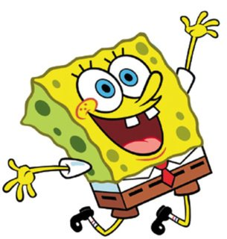
Sponge bob
Notes:
<numéro>

Slide 2
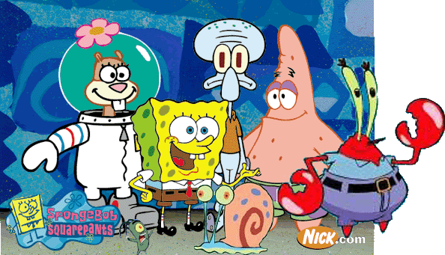
Sponge Bob is an American TV series by Stephen hillanburg, created in 1984.
Notes:
<numéro>

Slide 3
Sponge Bob is an American TV series by Stephen hillanburg, created in 1984.
Notes:
<numéro>

Slide 4
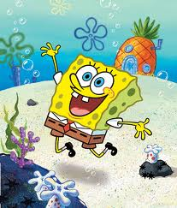
The series focuses on the exploits and adventures of a small yellow square sponge and his friends located at the bottom of the Atlantic Ocean in a town called « Bikini Bottom ».
Notes:
<numéro>

Slide 5
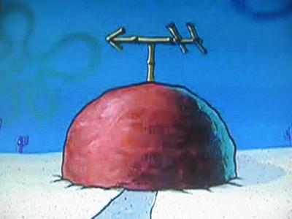
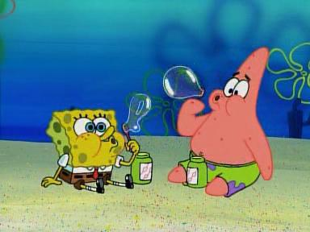
Sponge Bob's best friend is a starfish named Patrick who Lives next door to Bob. Nice and Pink he lives in a house made of rock.
Notes:
<numéro>

Slide 6
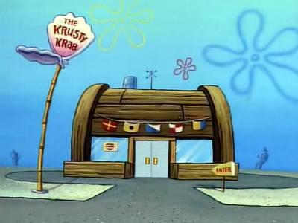
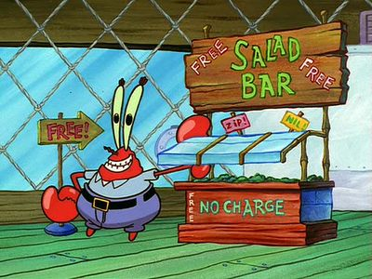
Bob works as a cook in a crabe restaurant run by a crab , a veteran of the wars , greedy, stingy, yet sympathetic : Captain Eugene Krabs and whose specialty is the « crab burger » best known as the « Crab block ».
Notes:
<numéro>

Slide 7
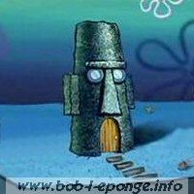
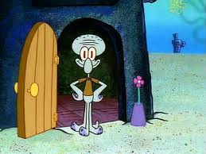
Carlo lives between the two friends. Carlo tentacles , an arrogant and asocial squid lives in a moai in Easter Island. His neighbours hate him because of his immature behavior.
Notes:
<numéro>

Slide 8
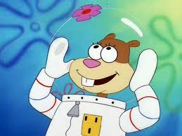
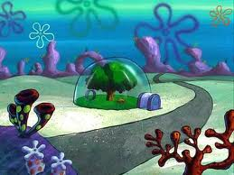
Another close friend of Sponge Bob is Sandy Squirrel , a groud squirrel from Texas. Sandy is an expert in karate and lives in an underwater dome. When under water , she wears a sort of astronaut combination because she can't breathe underwater.
Notes:
<numéro>

