Slide 1
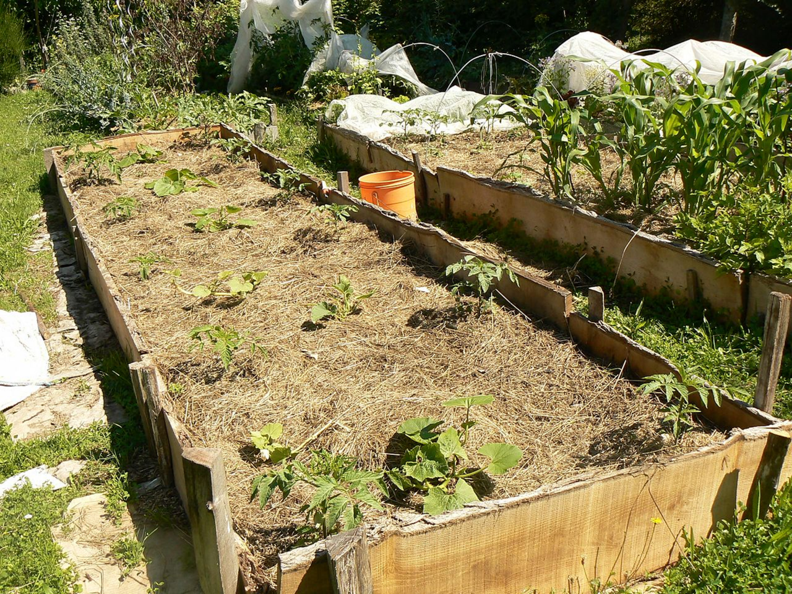
GREEN ACTIONS
EPI PERMACULTURE

Slide 2
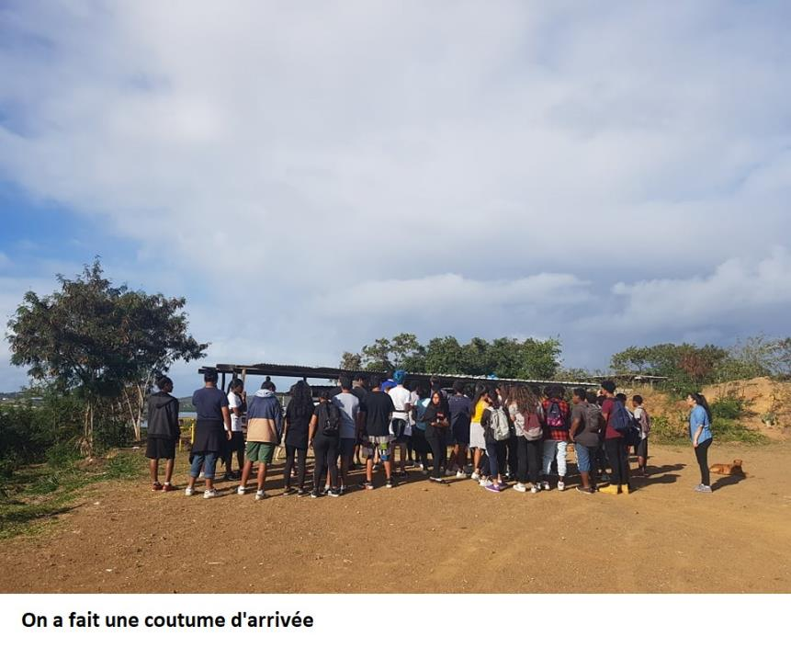
We made custom when we arrived

Slide 3
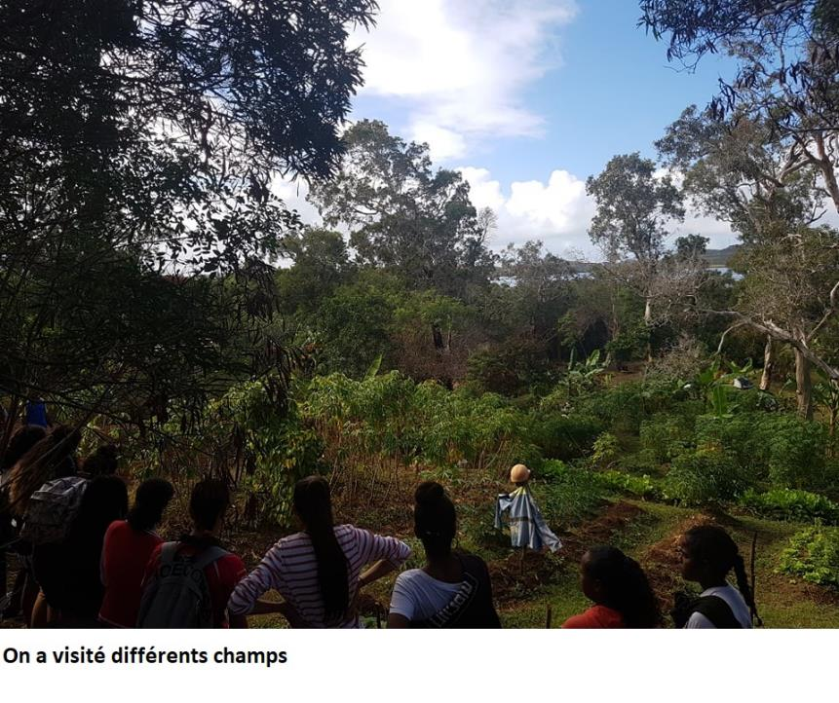
We visited DIFFERENT VISITED fields

Slide 4
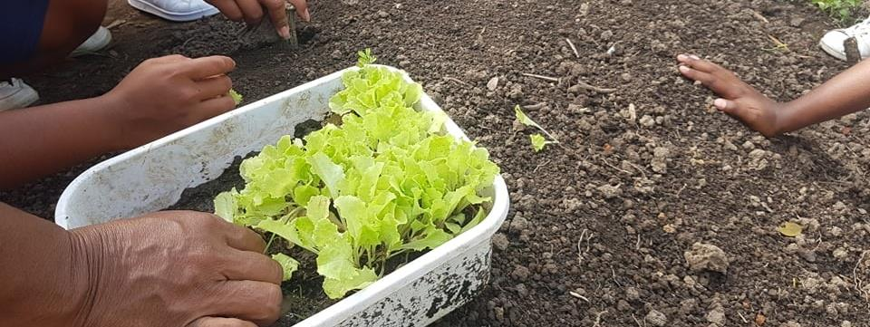
Lettuce weas planted to help a family of the tribe

Slide 5
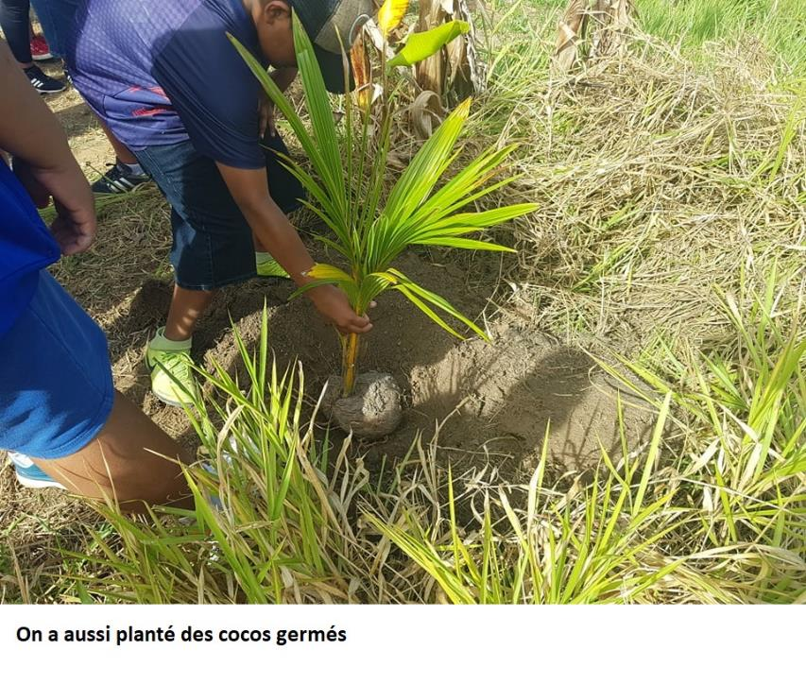
Sprouted coconuts were planted too

Slide 6
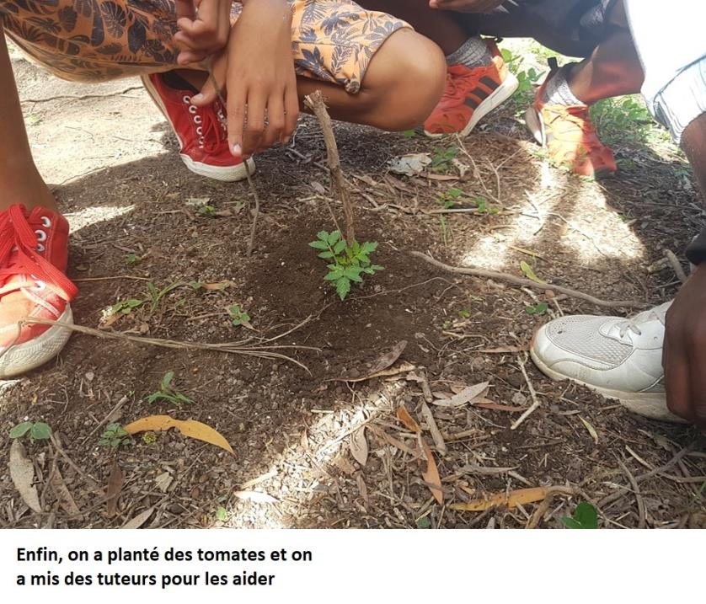
Finally, tomatoes were planted and tutors were put to help them grow

Slide 7
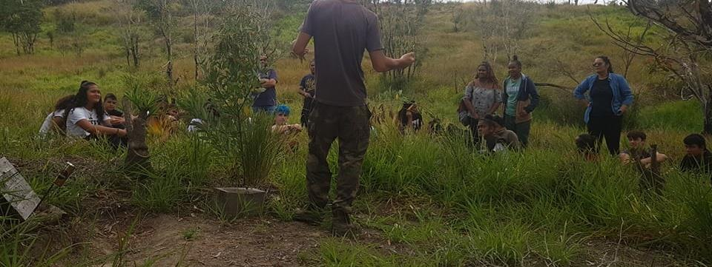
We were listening to alex who explained us how to grow vegetables

Slide 8
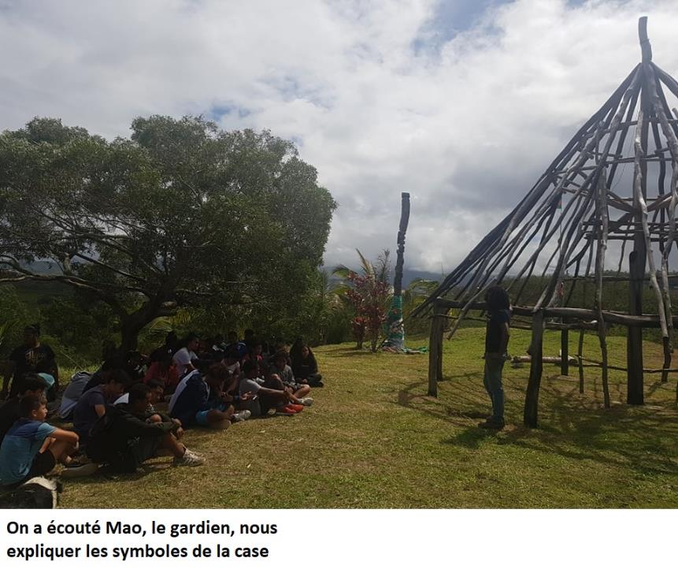
We were listening to mao, the guardian, who explained us the symbols of the traditionnal hut

Slide 9
Thank you
For your attention

